Slide 1
UNCONSCIOUS BIAS: The Impact on Populations
Dr. Kinneil Coltman Vice President Diversity & Inclusion
Statewide Population Health Collaborative I March 15, 2018

Slide 2
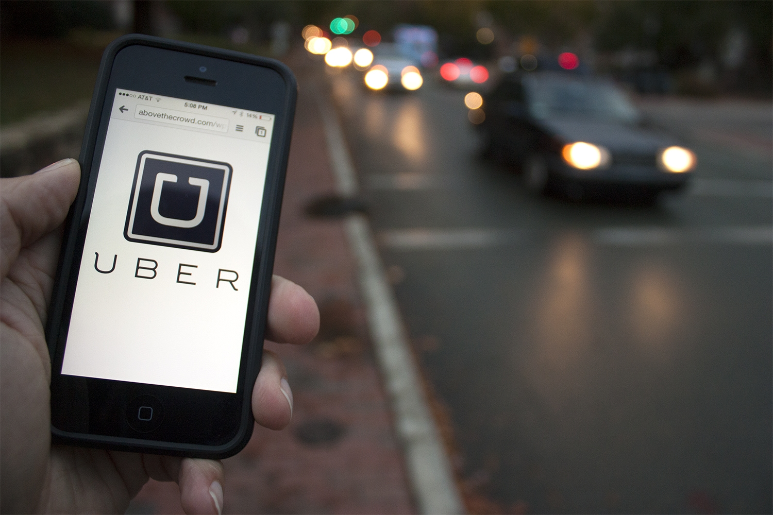
My Uber Story

Slide 4
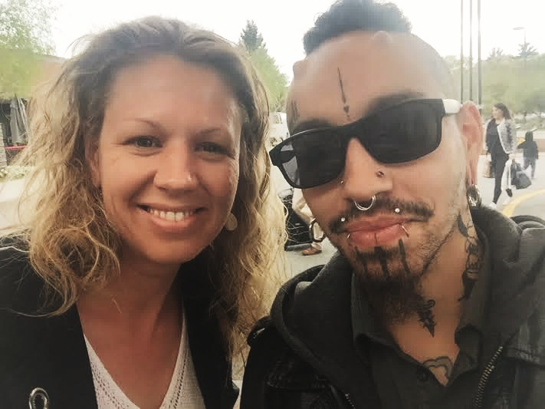

Slide 6
The Myth of Equal Treatment

Slide 7
So, what’s the big deal? Are we really THAT diverse?

Slide 8
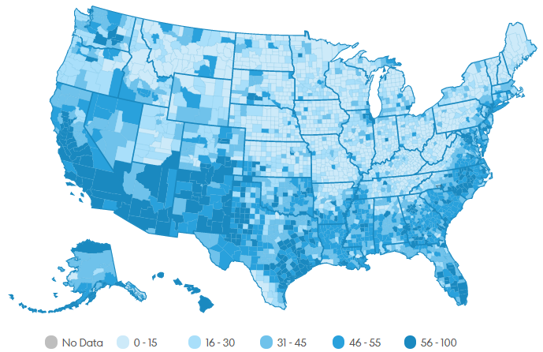
THE USA TODAY DIVERSITY INDEX
Notes:
USA TODAY used Census data to calculate the chance that two random people are different by race or ethnicity and came up with a Diversity Index to place every county on a scale of 0 to 100. The nationwide USA TODAY Diversity Index hit 55 in 2010. For the first time in history in the U.S., the next person you meet in this country — at work, in the library, at a coffee shop or a movie ticket line — will probably be of a different race or ethnic group than you.

Slide 9
2010

Slide 10
2020

Slide 11
2030

Slide 12
2040

Slide 13
2050

Slide 14
2060

Slide 15
2010
Forsyth County: 58
(Winston-Salem, Wake Forest Baptist Medical Center)
Durham County: 67
(Durham, Duke University Hospital)
Orange County: 47
(Chapel-Hill, UNC Hospitals)
Wake County: 56
(Raleigh)
Watauga County: 14
(Boone)
Guilford County: 60
(Greensboro)
Pitt County: 56
(Greenville)
Buncombe County: 28
(Asheville, Mission Health)
Craven County: 50
(New Bern, Carolina East Health System)
Moore County: 38
(Pinehurst, First Health of the Carolinas)
Mecklenburg County: 64
(Charlotte, Atrium Health, Novant Health)
New Hanover County: 39
(Wilmington)
Scotland County: 63
(Laurinburg, Scotland Memorial Hospital)

Slide 16
2020
Forsyth County: 62
(Winston-Salem, Wake Forest Baptist Medical Center)
Durham County: 69
(Durham, Duke University Hospital)
Orange County: 50
(Chapel-Hill, UNC Hospitals)
Wake County: 58
(Raleigh)
Watauga County: 16
(Boone)
Guilford County: 62
(Greensboro)
Pitt County:58
(Greenville)
Buncombe County:32
(Asheville, Mission Health)
Craven County: 53
(New Bern, Carolina East Health System)
Moore County: 42
(Pinehurst, First Health of the Carolinas)
Mecklenburg County: 66
(Charlotte, Atrium Health, Novant Health)
New Hanover County: 42
(Wilmington)
Scotland County: 65
(Laurinburg, Scotland Memorial Hospital)

Slide 17
The Difference That Differences Make in Health Care

Slide 18
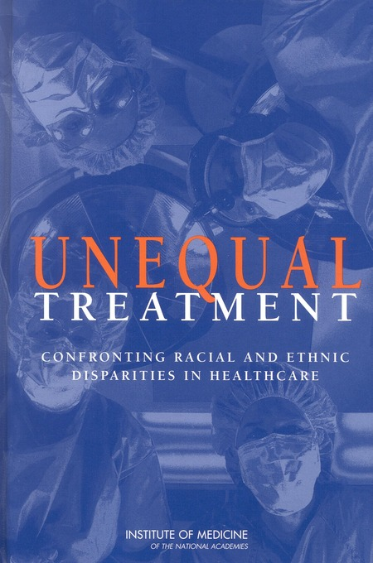
WHY IS UNCONSCIOUS BIAS A CONCERN FOR HEALTHCARE PROVIDERS?
Found significant variation in rates of medical procedures by race
U.S. racial and ethnic minorities experience a lower quality of health services
Provider bias was hypothesized to be one of many factors contributing to health disparities
Notes:
Commissioned by Congress. Published in 2003.
Found significant variation in rates of medical procedures by race, even when insurance status, income, age, and severity of conditions are comparable.
U.S. racial and ethnic minorities experience a lower quality of health services and are less likely to receive even routine medical procedures.
Physician bias was hypothesized to be one of many factors contributing to health disparities

Slide 19
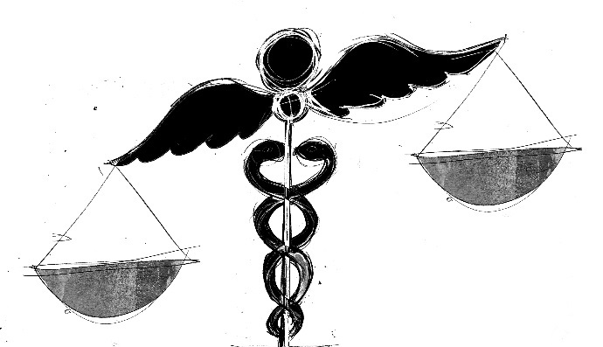
Minorities are less likely to…
Receive Appropriate Cardiac Medications
Undergo Cardiac Catheterization
Undergo Bypass Surgery
Receive Hemodialysis
Be Referred For Renal Transplantation
Receive Pain Medication
Receive Antiretroviral Therapy
Undergo Curative Surgery
DISPARITIES AT EVERY TURN
Source: Institute of Medicine. 2003. Unequal Treatment: Confronting Racial and Ethnic Disparities in Health Care. Washington, DC: The National Academies Press.
Notes:
Studies show that, even when accounting for socioeconomic status and insurance, minorities are less likely than whites to:
receive appropriate cardiac medications for coronary artery disease
undergo cardiac catheterization
undergo bypass surgery
receive hemodialysis for renal failure
be referred for renal transplantation once on dialysis
receive pain medication for long bone fractures in the ER
receive antiretroviral therapy for HIV
undergo curative surgery for lung cancer

Slide 20
So, what’s the big deal? Skyrocketing Costs & Changing Reimbursement
Joint Center Health Policy Institute
Found between 2003 & 2006 combined costs of health inequalities and premature death in U.S. were $1.24 trillion
Urban Institute
Projects $337 billion to be spent 2009-2018 on health care related to disparities
Sources: LaVeist, T. A., Gaskin, D. J., & Richard, P. (2013). The economic burden of health inequalities in the United States. 2009. Joint Center for Political and Economic Studies. Available at http://www. jointcenter. org.
Waidmann, T. (2009). Estimating the Cost of Racial and Ethnic Health Disparities.
Notes:
Eliminating health disparities for minorities would have reduced direct medical care expenditures by $229.4 billion for
the years 2003-2006.
Increasingly, health care providers will be reimbursed for their ability to ensure adherence to care and better patient outcomes.

Slide 21
Unequal Outcomes
What if a 747 crashed every day in the U.S.?
Source: The National Institute on Minority Health and Health Disparities (NIMHD)
Notes:
According to The National Institute on Minority Health and Health Disparities (NIMHD), “An estimated 265 DAILY deaths are attributable to racial and ethnic health disparities – the equivalent of a 747 crashing in the US every day. While plane crashes generate public outcry, where is the outcry for disparities?

Slide 22
BUT ARE ALL OF THESE INEQUALITIES INTENTIONAL?

Slide 23
How Many Triangles Do You See?

Slide 24
The “New Science” of Unconscious Bias

Slide 25
What is Unconscious Bias?
Unconscious biases are social stereotypes about certain groups of people that individuals form outside of their own conscious awareness
Nearly everyone has unconscious biases of some kind
Source: Fiske & Taylor 1991; Valian, 1998; 1999)
Notes:
It stems from our natural tendency to organize our social worlds by categorizing

Slide 26
Test Your Unconscious Biases
Harvard Implicit Association Test (IAT):
www.implicit.harvard.edu
Notes:
One of the most common measures of unconscious bias is the Harvard Implicit Association Test:
www.implicit.harvard.edu

Slide 27
WHO COMES TO MIND?
Teacher
Police Officer
CEO
Janitor
Physician
Secretary
Gang Member
Homeless Person
Construction Worker
Medicaid Patient
Attorney
Drug Seeking Patient

Slide 28
WHO gets hired…
Karen
Brian
Lakeisha
Emily
…and WHY?
Source: Steinpreis et al, 1999 Bertrain and Mullainathan, 2004
Notes:
Study: CV of a real psychologist (one at entry and one at tenure level) sent to 238 psychologists randomly selected from the APA directory (Steinpreis et al, 1999)
Each CV randomly assigned name of “Brian Miller” or “Karen Miller”
Findings
Evaluators were significantly more likely to hire “Brian” at entry level and to evaluate him more positively on research, teaching, and service.
At the tenure level
Evaluators were equally likely to tenure men and women
Four times more likely to include cautionary comments on CV’s with the female name
Study: Fictitious resumes (n=4,890) sent in response to 1,300 actual help wanted ads in Boston and Chicago for sales and clerical positions (Bertrain and Mullainathan, 2004)
Resumes adapted from those on career websites
2 high quality, 2 low quality
African American- or white-sounding names randomly assigned
Findings
Callback rate
10.0% for resumes with white-sounding names
6.6% for resumes with African American-sounding names
50% difference solely attributable to name manipulation
For “white-sounding” names, the applicants with better qualifications elicited 30% more callbacks than those with lower qualifications. For “African American-sounding” names, however, applicants with better qualifications only received 9% more callbacks.

Slide 29
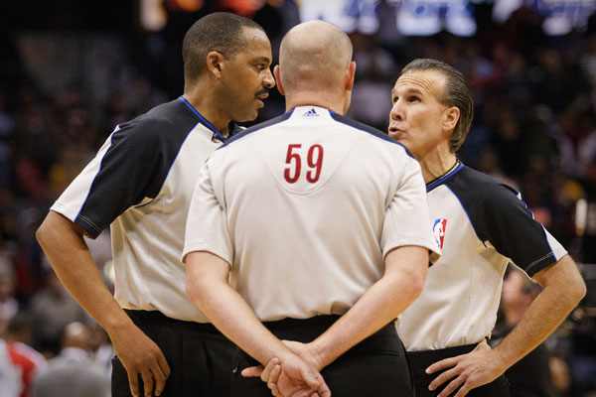
NBA Referees and Racial Bias
Source: Price, J & Wolfers, J. (2010). Racial Discrimination Among NBA Referees. The Quarterly Journal of Economics, 125 (4): 1859-1887.

Slide 30
Why is unconscious bias such a big deal in healthcare?

Slide 31
The Effect of Race and Sex on Physicians' Recommendations for Cardiac Catheterization
STUDY
720 physicians reviewed recorded interviews and data about a hypothetical patient, then made recommendations about that patient's care
FINDINGS
Women and blacks were less likely to be referred for cardiac catheterization than men and whites, respectively.
Black women were significantly less likely to be referred for catheterization than white men
Source: Schulman et.al. NEJM 1999;340:618.
Notes:
720 physicians viewed recorded interviews
Reviewed data about a hypothetical patient
The physicians then made recommendations about that patient's care
Women (OR = 0.60) and blacks (OR = 0.60) were less likely to be referred for cardiac catheterization than men and whites, respectively.
Black women were significantly less likely to be referred for catheterization than white men (OR= 0.4)

Slide 32
Groundbreaking Study on Implicit Bias & Physician Treatment Decisions
Source: Greene et al. J Gen Intern Med. 2007 September; 22(9): 1231–1238.
Notes:
Design, Setting, and Participants
An internet-based tool comprising a clinical vignette of a patient presenting to the emergency department with an acute coronary syndrome, followed by a questionnaire and three Implicit Association Tests (IATs). Study invitations were e-mailed to all internal medicine and emergency medicine residents at four academic medical centers in Atlanta and Boston; 287 completed the study, met inclusion criteria, and were randomized to either a black or white

Slide 33
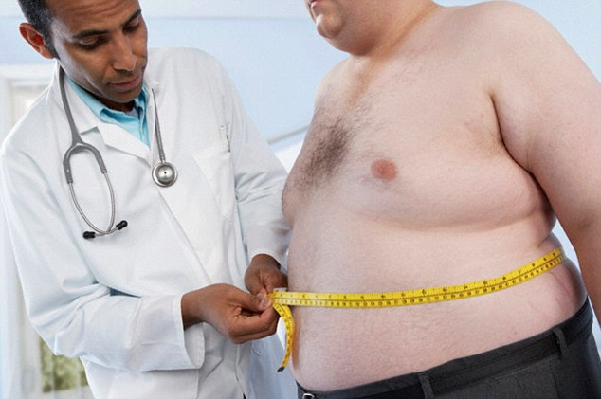
Physician Anti- Fat Bias
Source: Sabin JA, Marini M, Nosek BA (2012) Implicit and Explicit Anti-Fat Bias among a Large Sample of Medical Doctors by BMI, Race/Ethnicity and Gender. PLoS ONE 7(11): e48448.
Notes:
Researchers found strong implicit and explicit anti-fat bias is pervasive among MDs

Slide 34
Clinicians’ Implicit Ethnic/Racial Bias & Perceptions of Care
STUDY
Surveyed 2,908 patients, stratified by race/ethnicity; randomly selected from patient panels of 134 clinicians who had completed tests of explicit and implicit ethnic/racial bias.
FINDINGS
Explicit bias was low among physicians and unrelated to patients’ perceptions.
Physicians with greater implicit bias were rated lower by their black patients as compared with a reference group of white patients.
Latino patients gave clinicians lower ratings than other groups and this did not depend on the clinician’s implicit bias.
Source: Blair et al. Annals of Family Med. 2013 Jan/Feb; 11(1): 43–52.

Slide 35
Providers’ Nonverbal Communication May Differ by Race
Source: Elliott, et al. (2016). Differences in Physicians’ Verbal and Nonverbal Communication With Black and White Patients at the End of Life.
Notes:
33 hospital-based physicians completed two encounters with prognostically similar, critically and terminally ill black and white patients with identical treatment preferences
Physicians’ verbal communication scores did not differ by patient race
Physicians’ nonverbal communication scores were significantly lower with black patients than with white patients (black vs. white: 2.7 vs. 2.9, P-value 0.014)

Slide 36
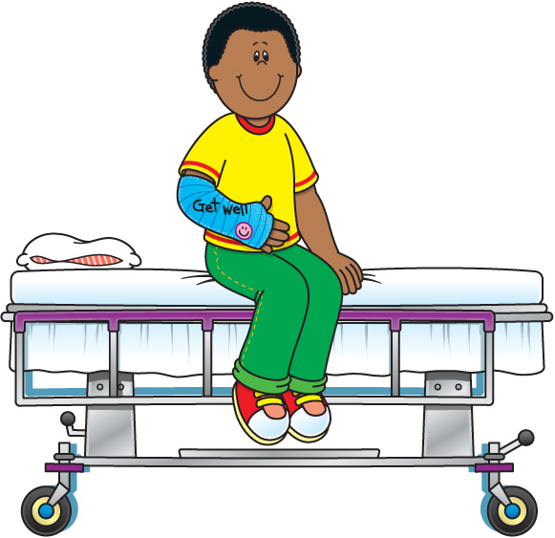
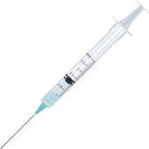
Interpretation of symptoms
Diagnosis/
Treatment Plan
Patient Behavior in Encounter
Patient’s thoughts and feelings
(e.g. acceptance of medical advice, attitude, self-efficacy)
Provider’s biases
(conscious or unconscious)
about patient
Patient Satisfaction
Patient’s biases
(conscious or unconscious)
about provider
Adherence
Provider Interpersonal cues toward patient
Treatment Received

Slide 37
When is Unconscious Bias in Action?
When there is a need for “cognitive shortcuts” and a lack of full information.
Physicians, like everyone else, use these “cognitive shortcuts.”
Situations characterized by:
time pressure
resource constraints
high cognitive demand

Slide 38
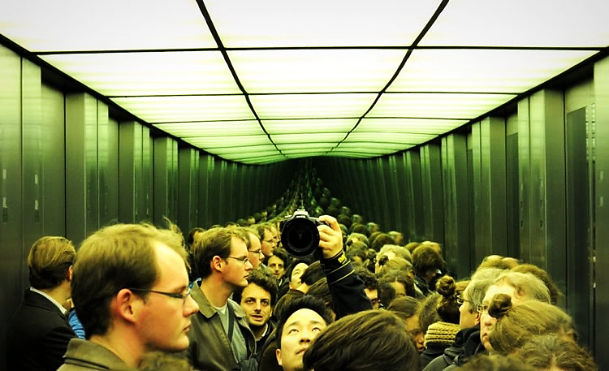
Unconscious Biases Multiply to Produce Unequal Outcomes in Populations

Slide 39
Priming
Reorganize structures and systems
Create forms of accountability based on outcomes…not good intentions
Notes:
1. Alert yourself to situations in which bias is more likely to be triggered

Slide 40
Moving From Equal Treatment To Equal Outcomes:
A CALL TO ACTION

Slide 41
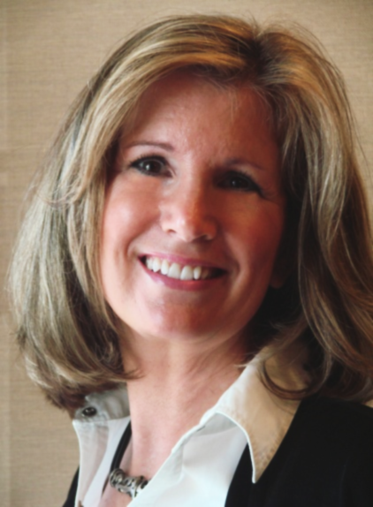
Rule #1: Patients First - Ensure High Quality Standardized Demographic Data Collection
Notes:
Who is coming in your doors? Do you know the race/ethnicity of your patient population?

Slide 42
Rule #2: Develop a Cadence for Examining Quality Metrics, Population Health & Patient Satisfaction by:
Race
Ethnicity
Language Preference
Sexual Orientation
Gender Identity

Slide 43
Rule # 3: Develop Goals & Interventions That Respond to Inequities

Slide 44
It’s in your hands….

