Slide 1
Physician Practice Acquisition Study: National and Regional Employment Changes
September 2016

Slide 2
About the Physicians Advocacy Institute
The Physicians Advocacy Institute (PAI) is a not-for-profit organization that was established to advance fair and transparent policies in the health care system to sustain the profession of medicine for the benefit of patients.
As part of this mission, PAI seeks to better understand the challenges facing physicians and their patients and also educate policymakers about these challenges.
PAI also develops tools to help physicians prepare for and respond to policies and marketplace trends that impact their ability to practice medicine.
Information about PAI can be found at physiciansadvocacyinstitute.org.

Slide 3
PAI: Committed to Researching Topics Important to Physicians and Patients
Through a research collaboration with Avalere Health, PAI is working to gain a more complete picture of the potential impact that various marketplace forces and private and public sector policies have on physicians and patients.
This report, summarizing national and regional changes in physician employment trends, highlights a significant shift in the landscape for practicing medicine in the U.S. Increasingly, physicians practice in the context of employment arrangements with health systems and hospitals. Understanding the extent of this trend provides a better understanding of today’s health care marketplace.
PAI and Avalere are planning a next phase of research in early 2017 to continue to build a better understanding of the implications of this trend.

Slide 4
What Types of Arrangements Contribute to This Trend?
The Avalere researchers’ findings summarized in the following slides show a consistent increase in physician employment stemming from:
continued growth in hospital and health system acquisitions of physician practices, which typically involve multiple physicians as well as acquisition of the practice’s physical building/equipment; and
sustained increases in the number of individual physicians entering into employment arrangements with hospitals and health systems.

Slide 5
Methodology

Slide 6
Methodology: Trends in Hospital Ownership of Physician Practices with Medicare-Billing Physicians
Avalere used an SK&A¹ database that contains physician² and practice location information on hospital/health system ownership:
Each record in the database corresponds to a unique physician in a specific practice location
The database identifies each physician-practice location combination as “employed”—part of a hospital or health system-owned practice—or “independent”
These data include solo and single-location small practices as well as large, multi-specialty multi-location group practices
The dataset covers seven different points in time from July 2012 to July 2015 for each physician-practice location combination
SK&A develops the physician affiliation flag through conducting bi-annual phone surveys with individual practice locations
1 SK&A is an organization that provides healthcare provider information and data solutions. http://www.skainfo.com/about#ims
2 Physicians are defined as MDs and DOs and does not include nurse practitioners or physicians assistant

Slide 7
Methodology: Trends in Hospital Ownership of Physician Practices with Medicare-Billing Physicians
Avalere linked the data from SK&A to the CMS National Plan & Provider Enumeration System (NPPES) by NPI³ to identify the primary address for the providers
Each record in the database corresponds to a unique physician in a specific practice location
3 NPI = National Provider Identifier

Slide 8
Highlights of Research Findings
Significant and Consistent Increases in Physicians Employment and Hospital Ownership of Practices
This research confirms a significant, nationwide shift in the number of physicians leaving private practice and entering into employment arrangement with hospitals and health systems.
The results show a dramatic increase in hospitals and health systems employing physicians and acquiring physician practices over a three-year period between July 2012 and July 2015.
National Trend:
From July 2012 to July 2015, the percent of hospital-employed physicians increased by almost 50 percent, with increases in each six-month time period measured over these three years.
Employment Trend Extends Across All Regions:
All regions saw an increase in hospital-employed physicians at every measured time period, with a range of total increase from 75-114 percent.

Slide 9
Between July 2012 and July 2015, the Number of Employed Physicians Increased to More Than 140,000
Change in employment of Physicians
Number of Hospital-EMPLOYED Physicians
Between 2012 and 2015, the number of physicians employed by hospitals grew by 46,000 nationwide.
Physician employment grew in each of the six-month periods analyzed.
In the six months from July 2014 to January 2015 alone, nearly 20,000 physicians shifted into employment models.
Avalere analysis of SK&A hospital/health system ownership of physician practice locations data with Medicare 5% Standard Analytic Files

Slide 10
Physician Employment Grew by 49 Percent from 2012 to 2015
Change in employment of Physicians
Percent of Hospital-EMPLOYED Physicians
In 2012, one in four physicians was employed by a hospital.
By 2015, 38 percent of physicians were employed by hospitals.
Growth occurred throughout the three-year period, with some of the fastest acceleration occurring in late 2014.
Avalere analysis of SK&A hospital/health system ownership of physician practice locations data with Medicare 5% Standard Analytic Files

Slide 11
Hospital or Health System Ownership of Physician Practices Grew by 86 Percent From 2012 to 2015
Change in ownership of physician Practices
Number of Hospital-Owned
Physician Practices (thousands)
Between 2012 and 2015, the number of physician practices employed by hospitals grew by 31,000 practices, which is an 86 percent increase over three years.
By 2015, 67,000 physician practices nationwide were hospital-owned.
In the six months from July 2014 to January 2015 alone, 13,000 physician practices were acquired.
Avalere analysis of SK&A hospital/health system ownership of physician practice locations data with Medicare 5% Standard Analytic Files

Slide 12
As of 2015, One in Four Physician Practices Was Hospital-Owned
Change in ownership of physician Practices
Percent of Hospital-Owned Physician Practices
In 2012, one in seven physician practices was owned by a hospital.
Hospital ownership of practices increased to 1 in 4 by 2015.
Growth occurred throughout the three-year period, with some of the fastest acceleration occurring in late 2014.
Avalere analysis of SK&A hospital/health system ownership of physician practice locations data with Medicare 5% Standard Analytic Files

Slide 13
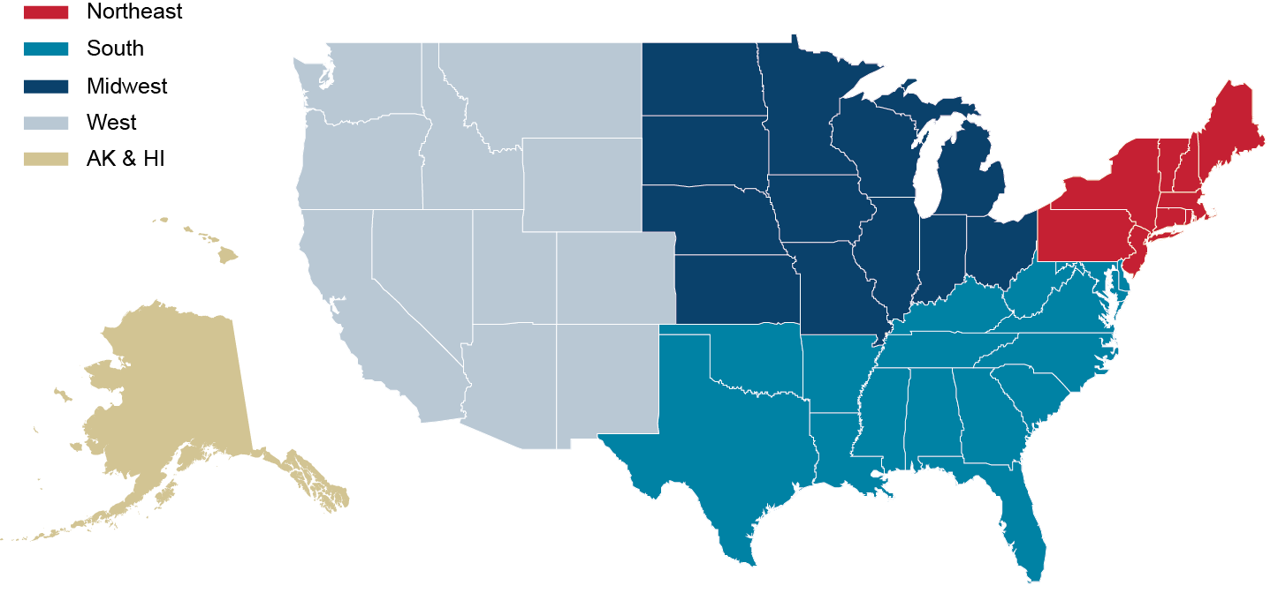
Regional Trends
Avalere also studied these trends by region. While there are differences across regions, there is a steady trend toward increased employment and hospital ownership of practices in every region of the nation.

Slide 14
The Share of Hospital-Employed Physicians Was Greatest in the Midwest
Hospital-employed Physicians by Region
Almost half of all physicians in the Midwest are employed by hospitals. Rates of employment are lowest in the South, where one-third of physicians are employed by hospitals, and in Alaska and Hawaii.
Avalere analysis of SK&A hospital/health system ownership of physician practice locations data with Medicare 5% Standard Analytic Files

Slide 15
In Every Region, Hospital Ownership Increased From 2012-2015
Hospital-Owned Practices by Region
More than one-third of Midwest physician practices were hospital-owned in 2015. Rates of practice ownership increased in every region over the entire time period.
Avalere analysis of SK&A hospital/health system ownership of physician practice locations data with Medicare 5% Standard Analytic Files

Slide 16
All Regions Have Seen Rapid Growth in Hospital Employment and Practice Ownership
Percent increase between july 2012 and july 2015
Avalere analysis of SK&A hospital/health system ownership of physician practice locations data with National Plan & Provider Enumeration System (NPPES) data on primary practice location by NPI

Slide 17
Impact of Increase in Physician Employment
The shift towards employment has significant implications for physicians, but also impacts patients and the system as a whole.
For physicians, the trend brings challenges but can alleviate certain burdens of independent practice. Government and private payer payment policies increasingly favor integrated health systems and make it challenging for physician practices to remain independent.
For patients, this trend may impact where they receive care and also how much they will pay in cost-sharing.
Overall system costs can increase as well.

Slide 18
How does the site of service delivery impact spending?
Medicare Payment Differentials Across Outpatient Settings of Care
In 2016, Avalere released a study in collaboration with PAI that documented the differential in Medicare payment for services routinely performed in hospital outpatient department (HOPD) and physician office settings.
This study underscores the impact that the ongoing shift towards hospital employment/hospital ownership of physician practices could have on spending, should this payment differential persist.
For the three types of services studied—cardiac imaging, colonoscopy, and evaluation and management services—Medicare pays more across an episode of care when patients receive services in a HOPD setting (even when it is in an stand-alone or “off-campus” building) than in a physician-owned office.
Data reflects 22-day episodes for cardiac imaging and colonoscopy and profile 2 for E&M. For detailed results and methodology please see complete paper.

Slide 19
www.PhysiciansAdvocacyInstitute.org

