Slide 1
NC Population Health Collaborative

Slide 2
THANK YOU

Slide 3
History of NC Population Health Collaborative
May 15, 2012--informal meeting that included:
Coastal Carolina Health Care—Stephen Nuckolls
Cornerstone Health Care—Grace Terrell, MD
Key Physicians—Ray Coppedge
Wilmington Health—Jeff James
Pinehurst Surgical—John Rezen
Community Care of NC—Allen Dobson, MD
December 13, 2012--First formal meeting of the NC ACO Collaborative, agreed to meet quarterly
December 2014—over 100 individuals on distribution list
NC ACO Collaborative—First and Third Quarters
NC MSSP (& Next Gen) Council—Second and Fourth Quarters
September 2015—NC ACO Collaborative becomes NC Population Health Collaborative
Today we have almost 300 individuals on the distribution list

Slide 4
NC Population Health Collaborative
The purpose of the NC Population Health Collaborative is
to bring together all members of the health care community to share experiences and ideas
to promote the successful transition to accountable, value-driven systems of care
that focus on attaining the Triple Aim of improving the health of populations, improving the patient experience of care (including quality and satisfaction), and reducing the per capital cost of health care.

Slide 5
Population Health Extends Beyond the Medical Community

Slide 6
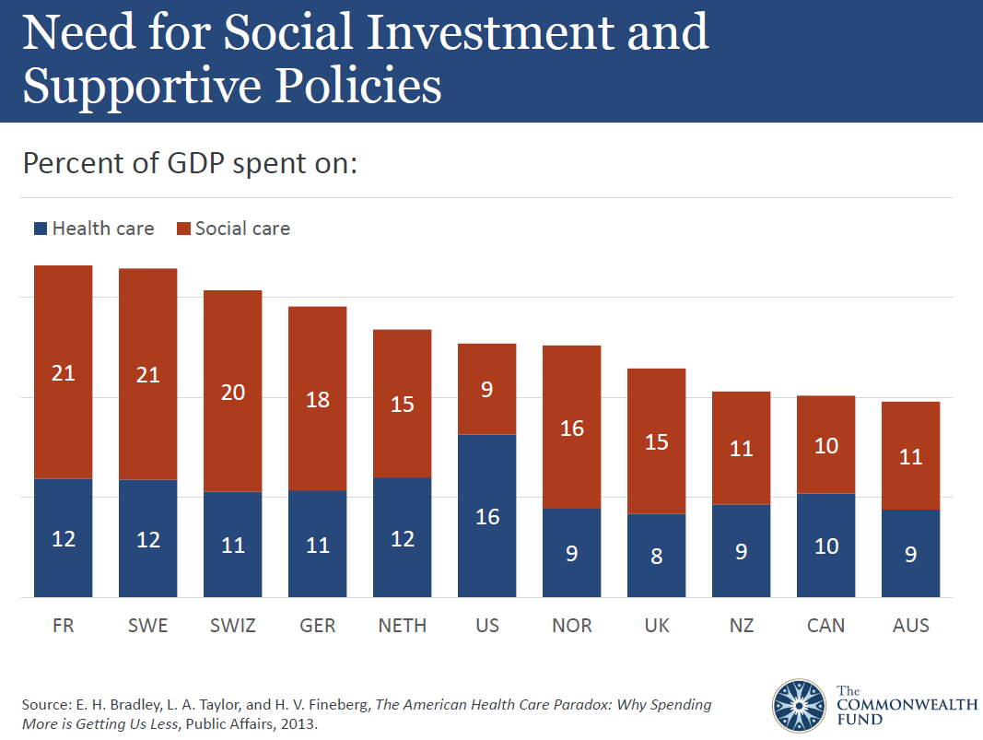

Slide 7
NC MSSP ACOs—initial year
April 2012
Accountable Care Coalition of Caldwell County
Accountable Care Coalition of Eastern NC
Coastal Carolina Quality Care (Advanced Payment)
July 2012
Cornerstone Health Care (now in Next Gen)
Triad HealthCare Network (now in Next Gen)
September 2012
None in NC
January 2013
Physicians Health Care Collaborative

Slide 8
2014 MSSP Starts
CaroMont Health
Carolinas ACO
Duke Connected Care
WakeMed Key Community Care
Bayview Physician Group
Central Virginia Accountable Care Collaborative, LLC
Health Choice Care, LLC
Primary Comprehensive Care ACO, LLC

Slide 9
2015 MSSP Starts
Cape Fear Valley Health System
Carolinas Medical Home Network ACO (AIM)
CHESS MSSP ACO*
Coastal Plains Network
Mission Health Partners
Pinehurst Accountable Care Network
Pioneer Health Alliance

Slide 10
2016 MSSP Starts
Physician Quality Partners
Tar River Health Alliance (AIM)
Winding River ACO (AIM)
CVCHiP

Slide 11
2017 MSSP Starts
Piedmont Community Health Collaborative
Onslow Partners in Care ACO
CHESS Value MSSP ACO
Sandhills Accountable Care Alliance
Novant Health ACO
WakeMed Key Community Care *
Southeastern Health Partners

Slide 12
Next Gen ACOs
2016
CHESS NG ACO (Cornerstone Health Care)
Triad HealthCare Network
WakeMed Key Community Care
2017
UNC Senior Alliance

Slide 13
Other CMS APMs
BPCI—39 locations across NC
CCJR
Pitt County
Buncombe, Haywood, Henderson, Madison Counties
Chatham, Durham, Orange, Person Counties
ESRD Seamless Care Organization
Fresenius Seamless Care of Charlotte
Fresenius Seamless Care of Raleigh

Slide 14
NC Commercial ACO Contracts
Accountable Care Alliance between Wilmington Health, NHRMC, BCBSNC
Boice-Willis Clinic--Cigna, 3 MA (A, H, U)
Carolinas Healthcare System--Aetna
CaroMont Health and CaroMont Medical Group—Cigna, Aetna, Coventry, 3 MA (C, Cov, H), SHP
CHESS--Aetna, BCBSNC, Cigna, Coventry, United
Duke Connected Care—Cigna
Duke Health and WakeMed--Aetna Whole Health, BCBSNC
Novant Health--Cigna
WakeMed Key Community Care--BCBSNC, Cigna, United, Aetna Whole Health
Mission Health Partners—2 MA (H, U) and their own MA
Novant Health--Cigna
Triad Healthcare Network--
UNC Health Alliance—Cigna
Wilmington Health--United

Slide 15
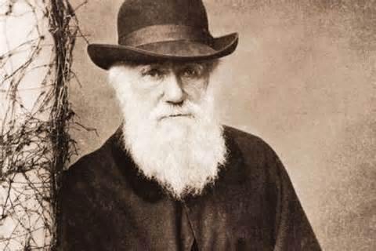
Thought for the Day
“It is not the strongest or the most intelligent who will survive, but those who can best manage change.”
~ Charles Darwin

Slide 16
Mount Sinai’s Population Health Vision

Slide 17
Housekeeping
Bathrooms
Future communications will be from ncmsfoundation@ncmedsoc.org
Registration will be through Cvent
NCMS Staff to contact with questions:
Melanie Phelps
Dana Lucas
NCHA Staff--tbd

