Slide 1
ACP Early Career MD Leadership Series: Experience of Downstate Illinois Janet A. Jokela, MD, MPH, FACP Governor, Downstate Region Illinois Chapter
January 26, 2016, CECP Webinar

Slide 2
Downstate IL Leadership Series
To engage Early Career MDs
Since at least 2011
Collaborative effort with other Chapters, National
gotomeeting.com
Chapter website, Governor’s newsletter, blast emails

Slide 4
Since 2011…
Offered 32 ECP Leadership Webinars
Approx. six to eight per year, evening
Sample topics:
Core Tenets of Leadership, Basics of Healthcare Finance, Case Studies in Leading Effective Change, Bending the Cost Curve and Improving Quality in One of America’s Poorest Cities (Jeff Brenner, MD), Negotiation Skills, Personal Financial Planning for MDs, Finding Joy in Medicine, How to Say No, Mentoring, What’s New at the Annals…
Speakers
Recorded: vimeo.com/acpillinois

Slide 6
https://attendee.gotowebinar.com/register/604635006717741569

Slide 7
Mentoring! ACP Early Career MD Leadership Series ACP Downstate Region, Illinois Chapter ACP SE Pennsylvania Chapter ACP Washington DC Chapter
January 27, 2016, 6:30 PM CST / 7:30 PM EST

Slide 8
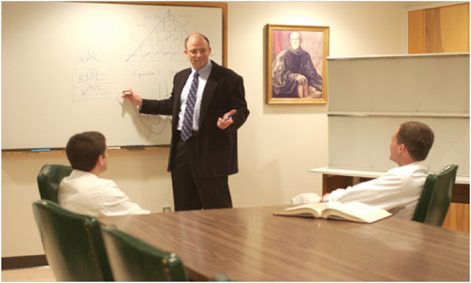
Jeffrey Wiese, MD, FACP, MHM Tulane University Internal Medicine Residency Program Director, Professor of Medicine, Senior Associate Dean GME, Chief of Charity Medical Service
Tonight’s Speaker

Slide 9
Upcoming ACP Events
Upcoming ACP Illinois Webinars!
Weds. Feb. 3, 5:30 PM CST—MACRA, Shari M. Erickson, MPH, Vice-President, Governmental Affairs and Medical Practice, ACP, Washington DC
Weds. March 9, 6:30 PM—EMR at the Bedside, Samer Badlani, MD, FACP, Intermountain Healthcare, Utah
Mon. March 21, 5:30 PM—Update in HCV, Janak Koirala, MD, FACP, Southern IL University
Weds. April 6, 6:30 PM—What’s New at the Annals, Christine Laine, MD, FACP, Editor in Chief, Annals of Internal Medicine
Mon. May 16, 5:30 PM—Applying to Subspecialty Fellowships, Andrew Varney, MD, FACP, Janet Jokela, MD, FACP
Mon. June 6, 5:30 PM—College Update, Susan Hingle, MD, FACP, Chair-Elect Designee, ACP Board of Regents
Leadership Day 2016, May 3-4, Washington DC
Internal Medicine 2016, May 5-7, Washington DC

Slide 10
Conclusions
Chapter Staff: key (thank you Donna Seawards!)
Engage ECPs in the process
Valuable service to members
Raises profile of ACP, promotes Chapter
Great way to collaborate, network

