Slide 1
Clinical and pathological classification of inflammatory myopathy
Nizar Chahin, M.D.
Neuromuscular section
UNC, Chapel Hill, NC

Slide 2
Why is it important to classify IM?
Some do not respond to immunotherapy (IBM)
Some are associated with cancer (DM)
Some are more refractory to immunotherapy (anti-SRP associated myopathy)
Some are associated with interstitial lung disease, antisynthetase syndrome (ASS)

Slide 3
Pathological classification
With predominantly endomysial inflammation
  IBM
  PM
  Myositis associated with SLE, Sjögren’s and RA
With predominantly perimysial inflammation
  DM
  Antisynthetase syndrome
  Myositis associated with SLE, Sjögren’s and RA, MCT, scleroderma
With minimal or no inflammation
  Signal recognition particle (SRP) antibody associated myopathy
  ? Statin-associated autoimmune myopathy

Slide 4
Illustrative Case
71 Y/O male with 2 year H/O of falls and progressive muscle weakness
Falls and difficulty getting up from low position and lifting his arms, difficulty holding the golf club, opening jars and door knobs
Examination: proximal and distal muscle weakness with absent tendon reflexes and normal sensory exam

Slide 5
Case presentation
EMG showed diffuse changes with +2-3 fibrillation potentials and myopathic MUP’s
Normal CK

Slide 6
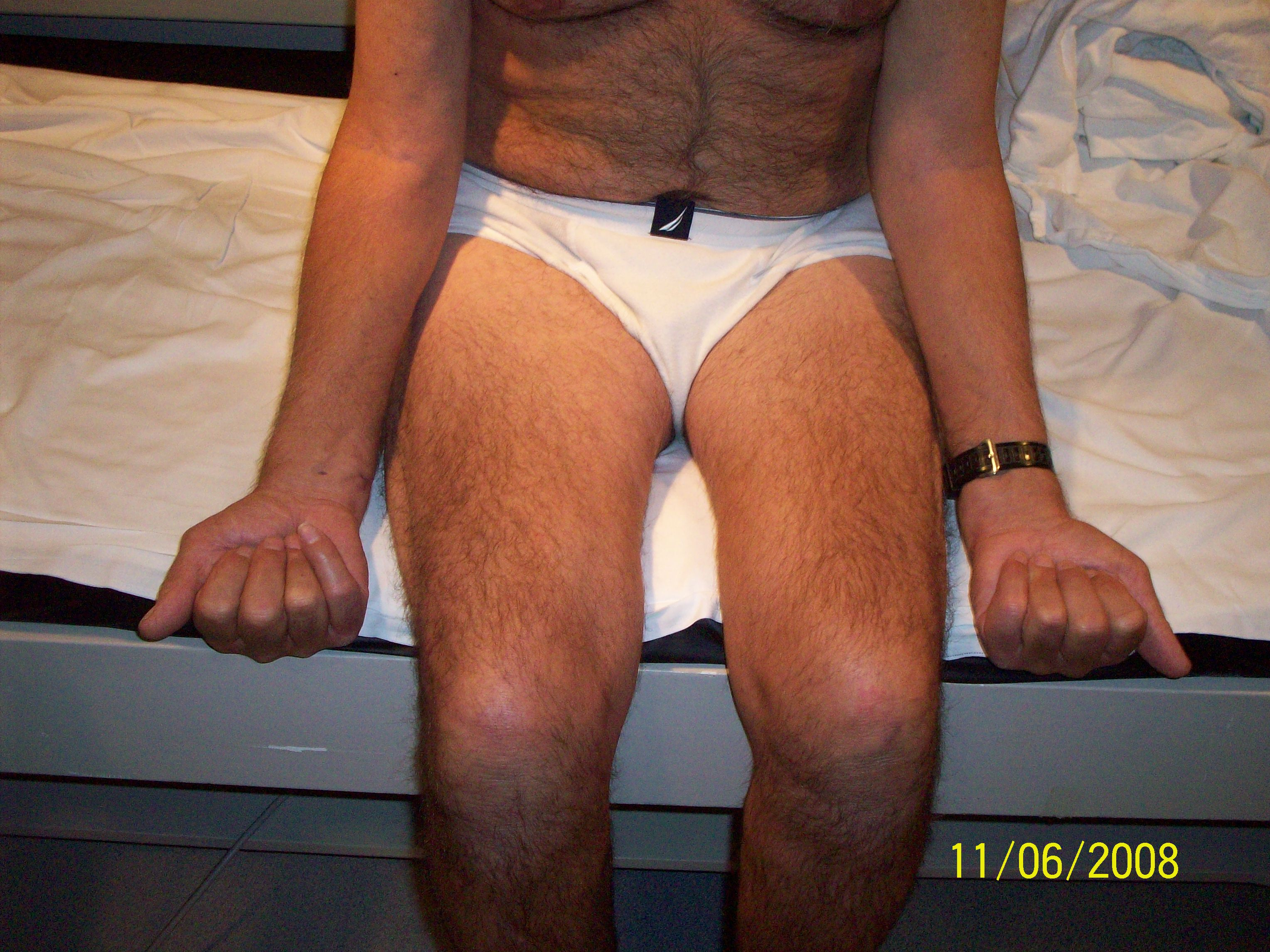
IBM

Slide 7
IBM
Slowly progressive, selective quadriceps and finger flexor, asymmetric muscle weakness
Facial weakness 30% and dysphagia 50%
After age 50
Male
CK normal (27%) or mildly elevated < 10 times
EMG, myopathic with mixed MUP’s, peripheral neuropathy in 30%
Notes:
Proximal and distal muscle weakness with selective

Slide 8
IBM
Life expectancy is usually not shortened
Most patients will need walking aids with 6-7 years from the onset of the disease
Rare patients die from aspiration pneumonia
Frequently missed diagnosed for motor neuron disease, CIDP and peripheral neuropathy

Slide 9
IBM pathogenesis
Pathogenesis unknown
? Primary inflammatory myopathy
? Primary degenerative disease of the muscle, similar to Alzheimer's disease

Slide 10
IBM muscle pathology
Invasion of non-necrotic fibers by mononuclear cells CD8+
Vacuolated muscle fibers
Intracellular congophilic deposits, or demonstration of 15-18 nm paired helical filaments by EM
Notes:
Demonstration of intracellular congophilic deposits

Slide 11
IBM muscle pathology
Groups of atrophic fibers
Mitochondrial abnormalities (ragged red and cytochrome c oxidase (COX)-negative fibers)

Slide 12
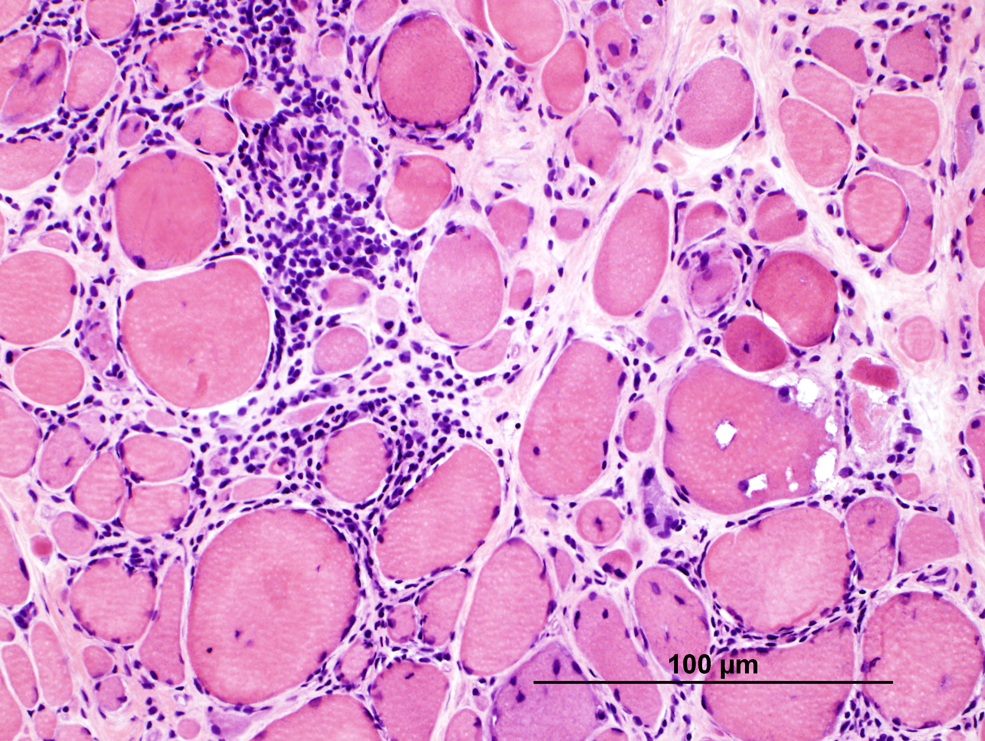
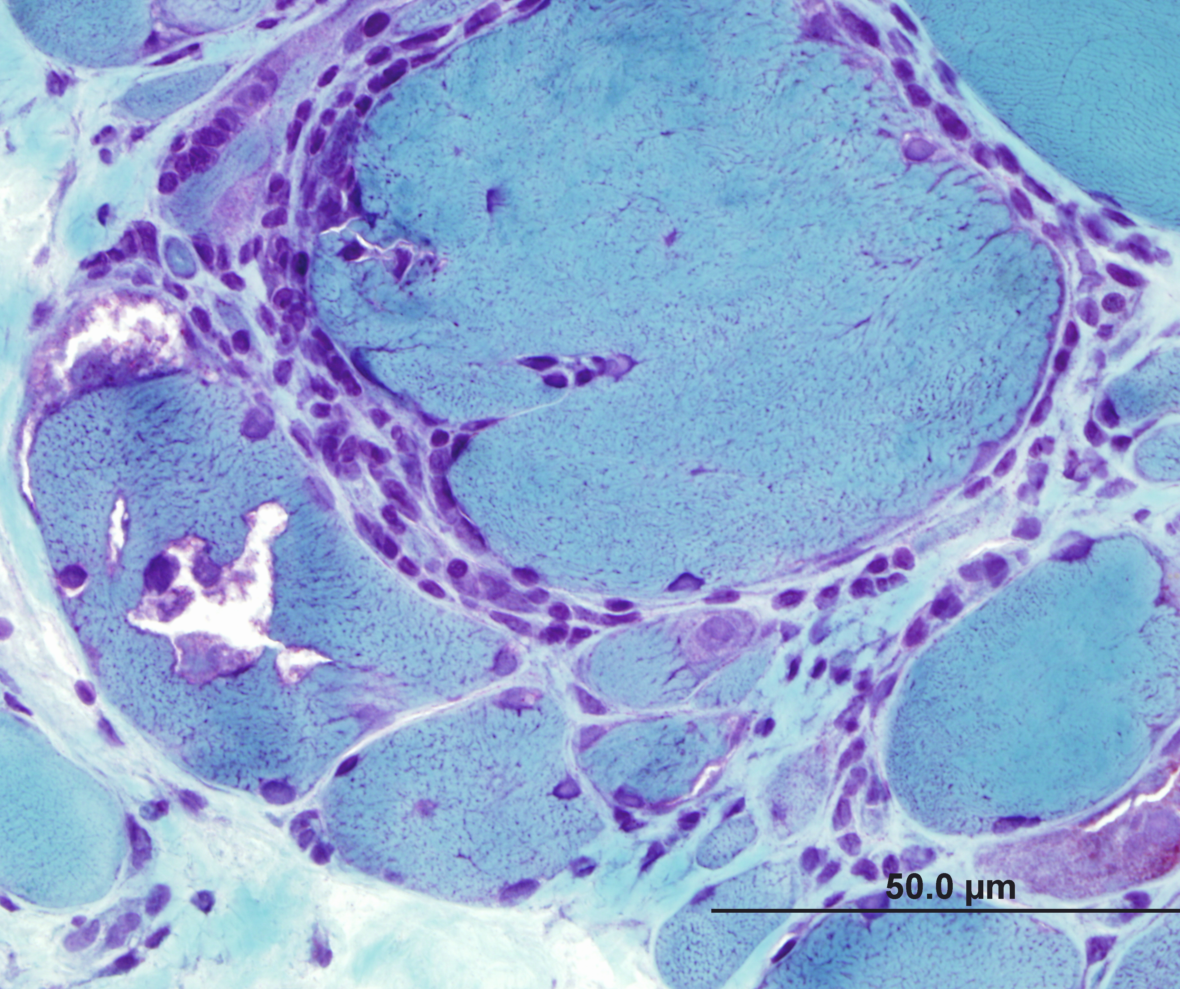
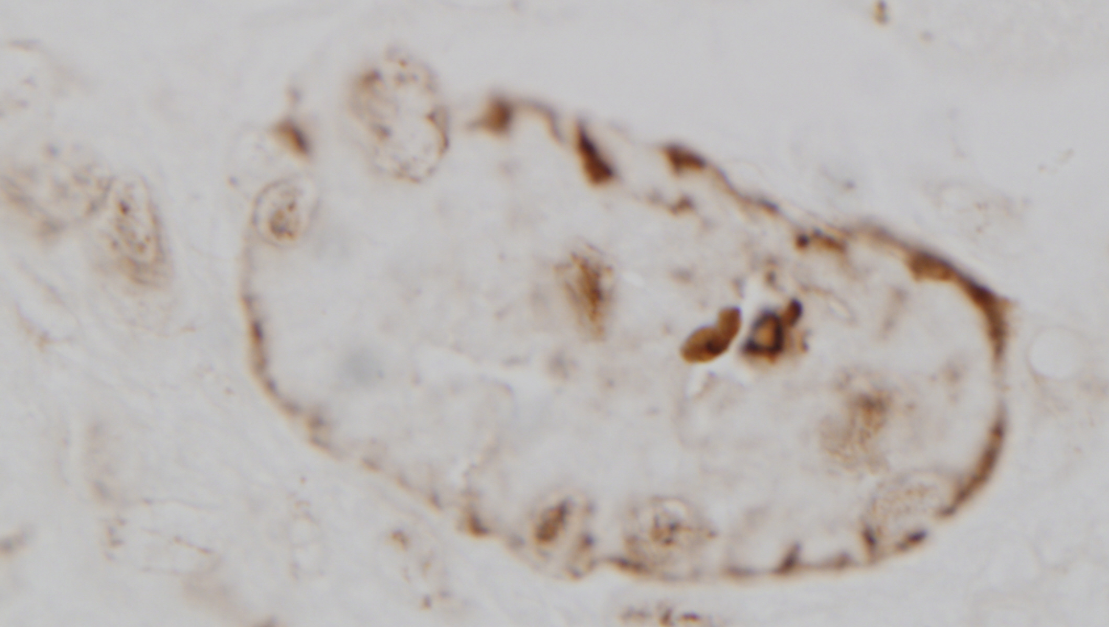
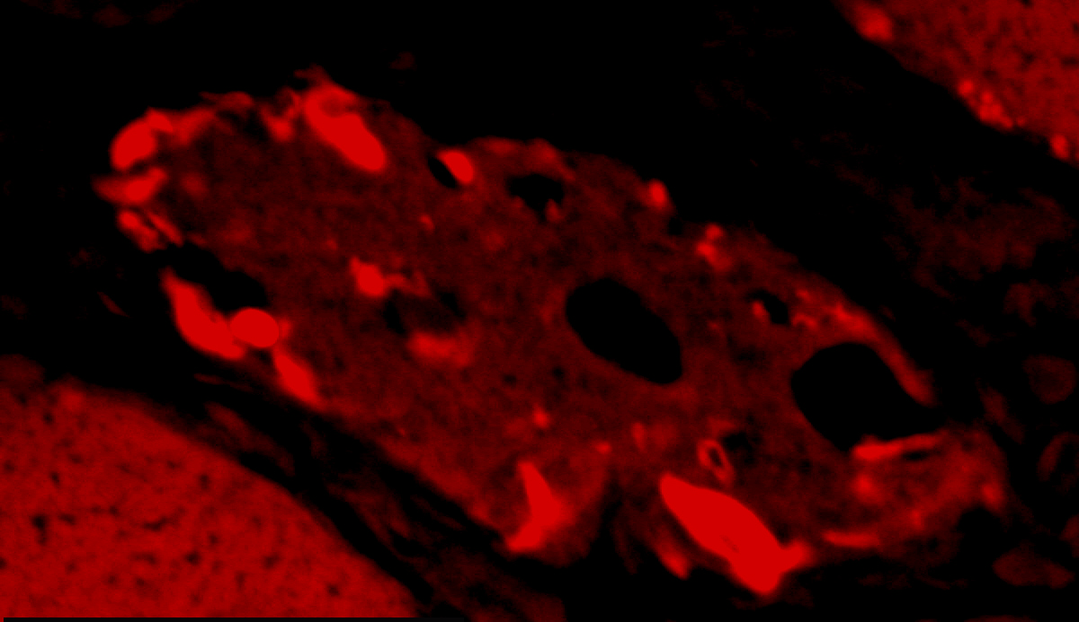
IBM muscle pathology
SMI-31
Notes:
SMI-31 a monoclonal protein against phosphorylated tau
Congo red staining under rodomine optics

Slide 13
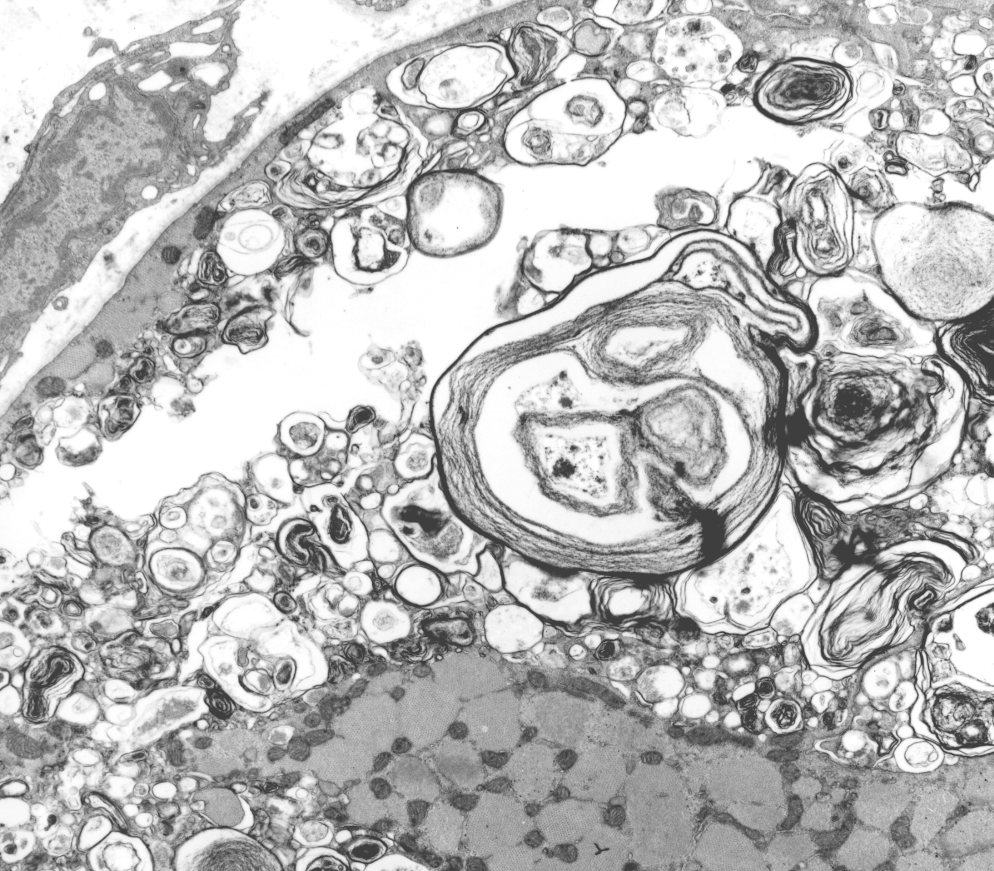
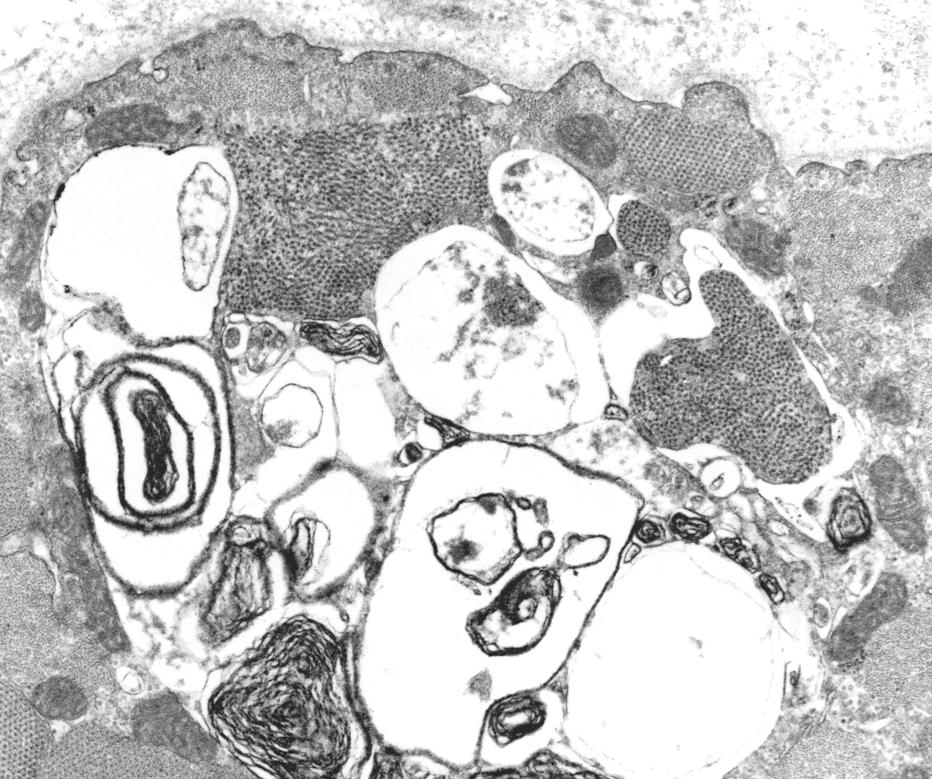
Vacuoles
Notes:
Autophagic, contain lysosomal membrane debris, myeloid features

Slide 14
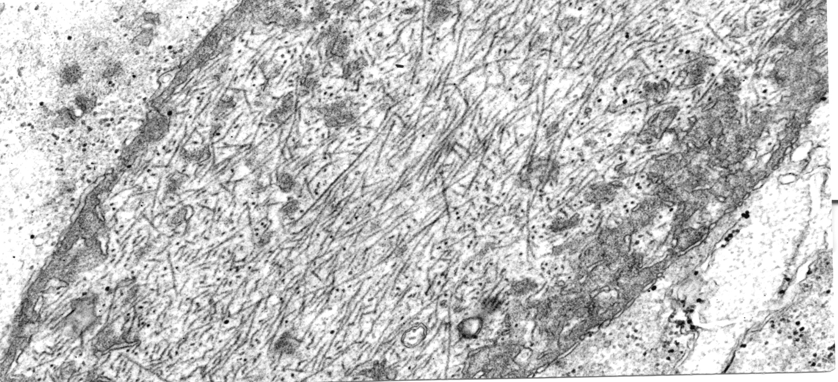
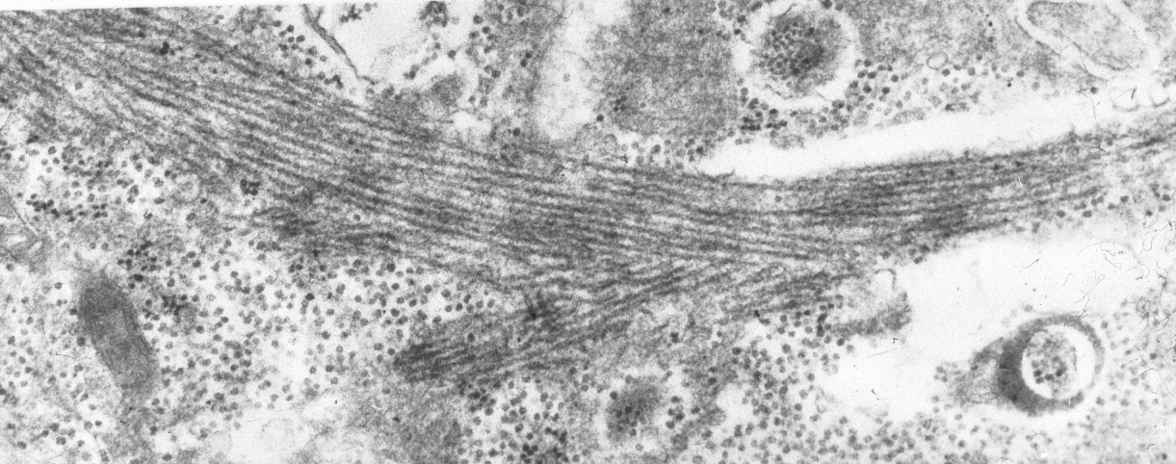
Inclusions
Notes:
Paired helical filaments

Slide 15
PM
Rare
Subacute predominantly symmetric proximal muscle weakness
Younger age than IBM
Female
CK elevated, occasionally up to 50 times the normal, rarely can be normal
Notes:
Patients with Pm usually present with subacute

Slide 16
PM Pathogenesis
CD8+ cytotoxic T cell invasion of none necrotic muscle fibers
Abundance of immunoglobulin gene transcripts by DNA microarray studies
Abundance of plasma cells and myeloid dendritic cells
Clonal expansion of T cell with restricted CDR3
Notes:
The pathogenesis is similar to the inflammatory process in IBM

Slide 17
PM muscle pathology
Inflammatory exudate in muscle with or without invasion of nonnecrotic fibers by mononuclear cells
Absence of pathologic features of IBM and DM

Slide 18
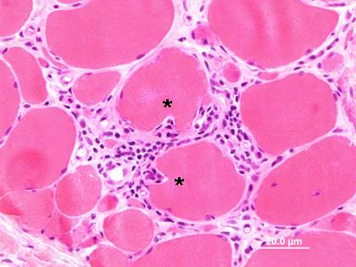
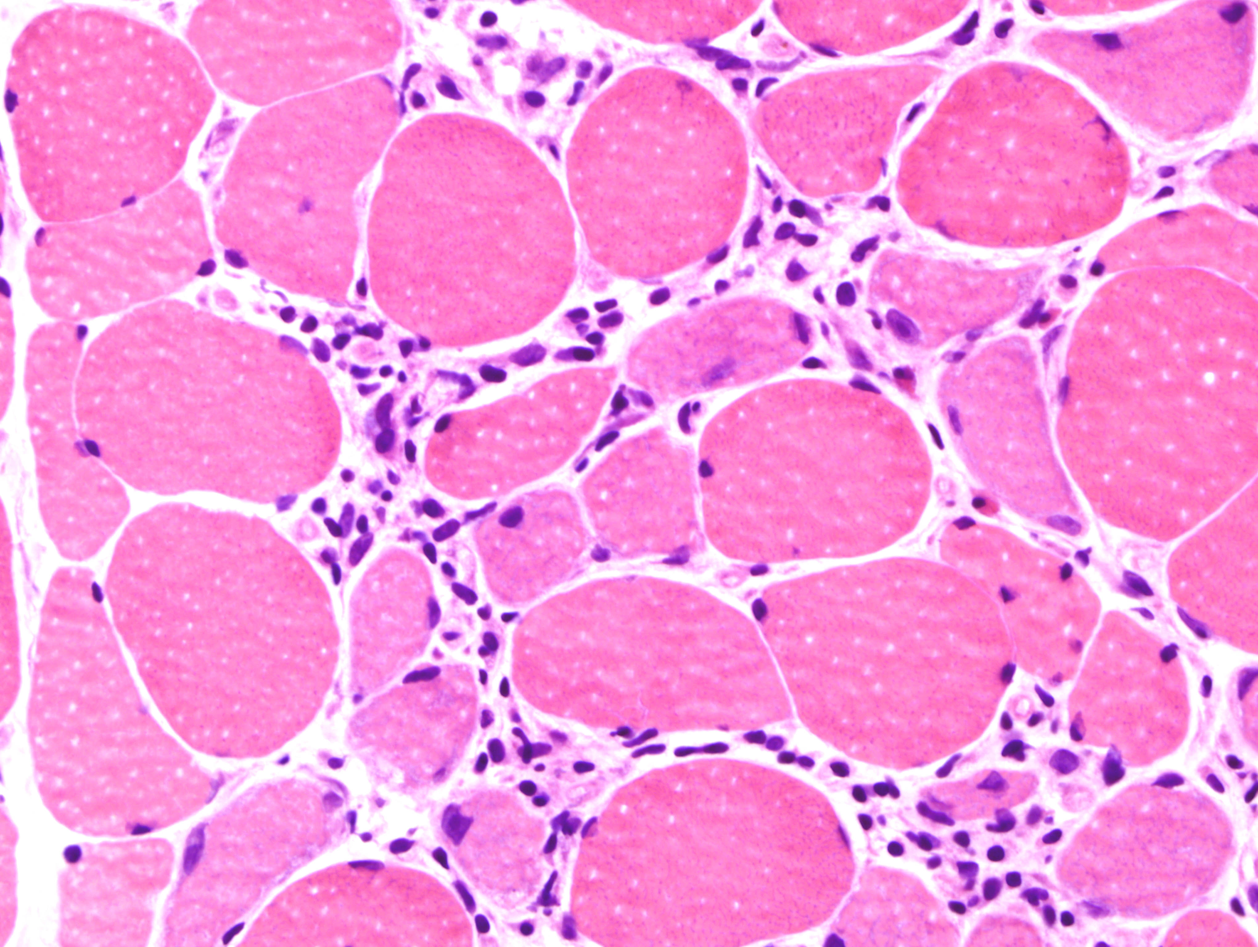
PM pathology

Slide 19
PM, IBM and PM/IBM cases, 1998-2003
  Pts initially diagnosed as PM, IBM, or PM/IBM: 146
  Pts available for follow-up: 107
    PM by clinical and biopsy criteria: 27
    IBM by clinical and biopsy criteria: 64
    PM/IBM: PM by biopsy criteria but IBM clinically: 16
Notes:
Over 5 years period there were 146 patients diagnosed as IM. 27 patients met the clinical and biopsy criteria for the diagnosis of PM

Slide 20
Demographics
 | PM | IBM | PM/IBM
No of patients | 27 | 64 | 16
Age at time of biopsy Range | 56.1 ± 10.9 (28-75) | 66.7 ± 8.9 (39-85) | 68.6 ± 11.3 (45-86)
M:F | 8:19 | 42:22 | 5:11
No. of pts who received immunotherapy before biopsy | 9 | 12 | 0
Followup after biopsy, yrs | 3.3 ± 1.8 | 3.3 ± 2.1 | 5.4 ± 1.8
Disease duration at last followup, yrs | 5.9 ± 4.4 | 8.5 ± 5.1 | 9.6 ± 4.4

Slide 21
Demographics
 | PM | IBM | PM/IBM
No of patients | 27 | 64 | 16
Age at time of biopsy Range | 56.1 ± 10.9 (28-75) | 66.7 ± 8.9 (39-85) | 68.6 ± 11.3 (45-86)
M:F | 8:19 | 42:22 | 5:11
No. of pts who received immunotherapy before biopsy | 9 | 12 | 0
Followup after biopsy, yrs | 3.3 ± 1.8 | 3.3 ± 2.1 | 5.4 ± 1.8
Disease duration at last followup, yrs | 5.9 ± 4.4 | 8.5 ± 5.1 | 9.6 ± 4.4

Slide 22
PM/IBM patients
16 of 43 (37%) pts with biopsy features of PM had clinical features of IBM
Conversely,16 of 80 (20%) pts with clinical features of IBM lack canonical histological markers of IBM
Females were significantly over-represented
Repeat biopsies in 3 pts 1, 4 and 6 yrs after first biopsy still lacked canonical IBM features in either proximal or distal muscles

Slide 23
Serum CK levels
 | PM (27) | IBM (64) | PM/IBM (16)
Mean ± SD | 2,199 ± 3078 | 546 ± 571 | 570 ± 383
Range | 50 - 13,254 | 67 - 3,883 | 200 - 1,490
Median | 1015 | 402 | 428
Pts with normal CK | 4/27 | 17/63 | 1/16

Slide 24
Serum CK levels
 | PM (27) | IBM (64) | PM/IBM (16)
Mean ± SD | 2,199 ± 3078 | 546 ± 571 | 570 ± 383
Range | 50 - 13,254 | 67 - 3,883 | 200 - 1,490
Median | 1015 | 402 | 428
Pts with normal CK | 4/27 | 17/63 | 1/16

Slide 25
Association with other autoimmune diseases
 | PM (27) | IBM (64) | PM/IBM (16)
Total with other autoimmune disease | 4 | 8 | 1
Hashimoto’s thyroiditis | 1 | 2 | -
Celiac disease | - | 2 | -
Idiopathic thrombocytopenic purpura | - | - | 1
Sjögren’s syndrome | 1 | 3 | -
Rheumatoid arthritis | 2 | 1 | -
Ocular MG | - | 1 | -

Slide 26
Association with autoimmune markers^{а} Positive test/Pts tested
 | PM (27) | IBM (64) | PM/IBM (16)
Total with immune markers | 8/25 | 18/51 | 5/14
ANA | 4/24 | 8/49 | 1/14
SSA | 2/19 | 8/40 | 0/13
SSB | 1/19 | 6/40 | 0/13
Jo1 | 1/19 | 0/40 | 0/13
RF | 4/17 | 10/27 | 5/10
Monoclonal protein | 0/14 | 3/29 | 2/11
Anti-AChR antibody | 1/12 | 1/30 | 0/9
Thyroid antibodies | 1/3 | 2/3 | 0/1

Slide 27
Muscle biopsy findings
 | PM (27) | IBM (64) | PM/IBM (16)
No. of pts with nonnecrotic fibers invaded by mononuclear cells | 17 | 64 | 13
Invaded fibers/cm² (mean, median) | 14, 9 | 51, 46 | 28, 17
Number of pts with COX-negative fibers | 20 | 63 | 16
COX-negative fibers/cm² (mean, median) | 84, 15 | 243, 169 | 251, 91

Slide 28
Muscle biopsy findings
 | PM (27) | IBM (64) | PM/IBM (16)
No. of pts with nonnecrotic fibers invaded by mononuclear cells | 17 | 64 | 13
Invaded fibers/cm² (mean, median) | 14, 9 | 51, 46 | 28, 17
Number of pts with COX-negative fibers | 20 | 63 | 16
COX-negative fibers/cm² (mean, median) | 84, 15 | 243, 169 | 251, 91

Slide 29
Muscle biopsy findings
 | PM (27) | IBM (64) | PM/IBM (16)
No. of pts with nonnecrotic fibers invaded by mononuclear cells | 17 | 64 | 13
Invaded fibers/cm² (mean, median) | 14, 9 | 51, 46 | 28, 17
Number of pts with COX-negative fibers | 20 | 63 | 16
COX-negative fibers/cm² (mean, median) | 84, 15 | 243, 169 | 251, 91

Slide 30
Effects of immunotherapy
 | PM (27) | IBM (64) | PM/IBM (16)
Treated | 27 | 32 | 14
Improved | 22 | 2 | 1
Stabilized | 2 | 1 | 4
Worsened | 0 | 28 | 9
Response not known | 3 | 1 | 0
Untreated | 0 | 32 | 2
Improved | 0 | 0 | 0
Stabilized | 0 | 4 | 0
Worsened | 0 | 26 | 1
Response not known | 0 | 2 | 1
ªtransient

Slide 31
Effects of immunotherapy
 | PM (27) | IBM (64) | PM/IBM (16)
Treated | 27 | 32 | 14
Improved | 22 | 2 | 1
Stabilized | 2 | 1 | 4
Worsened | 0 | 28 | 9
Response not known | 3 | 1 | 0
Untreated | 0 | 32 | 2
Improved | 0 | 0 | 0
Stabilized | 0 | 4 | 0
Worsened | 0 | 26 | 1
Response not known | 0 | 2 | 1

Slide 32
Effects of immunotherapy
 | PM (27) | IBM (64) | PM/IBM (16)
Treated | 27 | 32 | 14
Improved | 22 | 2 | 1
Stabilized | 2 | 1 | 4
Worsened | 0 | 28 | 9
Response not known | 3 | 1 | 0
Untreated | 0 | 32 | 2
Improved | 0 | 0 | 0
Stabilized | 0 | 4 | 0
Worsened | 0 | 26 | 1
Response not known | 0 | 2 | 1

Slide 33
Therapy
Therapy in PM, IBM and PM/IBM consisted of
  Prednisone (25, 25, 12)
  Methotrexate (16, 8, 6)
  Azathioprine (5, 8, 6)
  IVIG (6, 10, 2)
  Mycophenolate Mofetil (10, 3, 2)
  Cyclosporin (0, 0, 3)
  Plasmapheresis (0, 1, 0)

Slide 34
Study results
The incidence of autoimmune disease and/or markers is the same in all three groups
19 patients (18%) with PM have no associated autoimmune disease or marker
The frequency of invaded and cytochrome-c oxidase negative fibers are significantly higher in IBM than PM
The characteristic histological features of IBM was absent in 10% of men and 33% of women

Slide 35
Study results
37% of patients with biopsy features of PM had clinical features of IBM.
Absence of canonical biopsy features of IBM (total 20%) from clinically affected muscles of IBM patients challenges biopsy criteria for IBM.
IBM markers appear late in some patients, or their distribution in muscle is patchy and restricted compared to that of the inflammatory exudate.

Slide 36
Study results
The muscle biopsy is a reliable instrument in the diagnosis of PM and IBM in close to 85% of the patients
Errors of diagnosis in the remaining 15% can be avoided or reduced by combined evaluation of the clinical and pathologic findings

Slide 37
Illustrative Case
45 Y/O male with 7 month history of rapidly progressive, proximal more than distal muscle weakness
Two months after onset noticed a lump at the angle of his left neck
Five months later noticed his face is getting red
Used to smoke a 1 ½ pack for 15 years, quitted 20 years ago

Slide 38
Case presentation
CK 6295 U/L, AST 391 U/L, ALT 267 U/L, ANA speckled type, titer > 1:640
Normal ENA, DNA, RF, paraneoplastic panel and myositis profile
Negative CT chest, abdomen and pelvis with contrast
Normal colonoscopy and serum PSA

Slide 39
Case presentation
Moderately severe proximal more than distal muscle weakness
Normal tendon reflexes and sensory exam
Hard, immobile, none tender mass at the angle of the left jaw
Skin changes

Slide 40
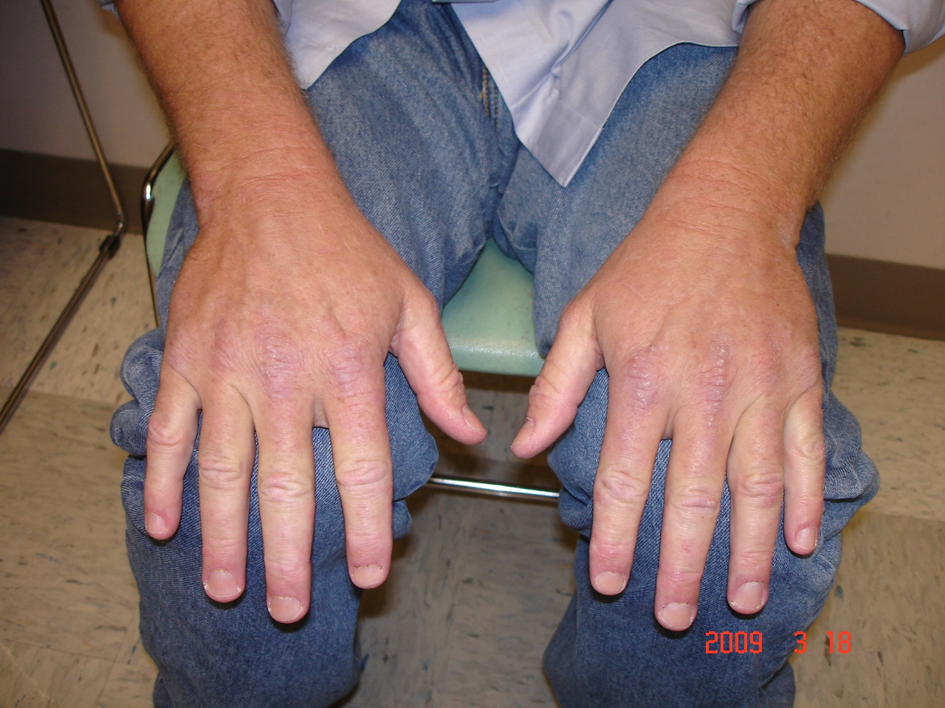

Case presentation

Slide 41
Case presentation
CT of the neck: none specific enhancing mass anterolateral to the left common carotid artery
FNA consistent with squamous cell carcinoma
Modified radical neck dissection
Treated with prednisone 1 mg/kg and Methotrexate 10 mg once a week with folic acid with marked improvement of his symptoms at 2 months, normal CK

Slide 42
Dermatomyositis
Subacute or chronic proximal more than distal muscle weakness
Characteristic skin rash consisting
  heliotrope rash
  poikilodermatous macular rash on neck or anterior chest ( V sign) or back and shoulders (shawl sign)
  Gottron’s sign a raised violaceous rash or papules at the knuckles

Slide 43
Dermatomyositis
CK usually elevated, but it could be normal
Can be associated with interstitial lung disease and JO1
Usually associated with Mi-2 antibody
High association with malignancy, usually over age 50
Notes:
The detection of neoplasm may precede or follow the onset of DM, the malignancy develop within a year of each other.

Slide 44
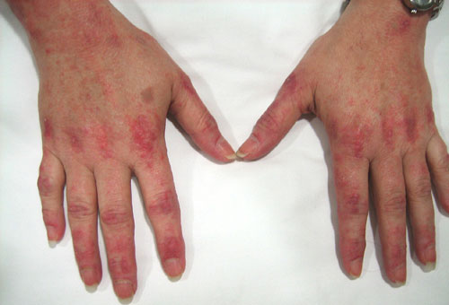
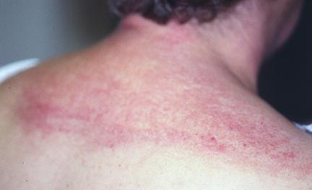
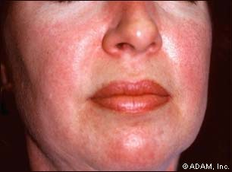
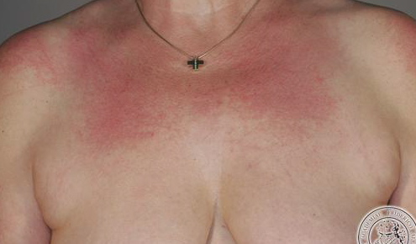
Skin manifestations of DM

Slide 45
DM Pathophysiology
B-cell mediated microangiopathy
B cells and CD4+ T cells
Complement activation and deposit of membrane attack complex (MCA) at the microvessel
Capillary depletion
Microarray studies of pooled RNA samples showed over expression of genes induced by interferon α/β
Abundance of plasmacytoid dendritic cells
Notes:
Plasmacytoid DC’s play an important role in the innate immune system. They are capable of producing large amounts of interferons INF-alpha and beta, which have multiple functions including stimulating tissue to produce intracellular proteins capable of providing defense against against pathogens

Slide 46
DM muscle pathology
Preferential involvement of the perifasicular regions
Acutely, necrosis, regeneration, vacuolar changes
Chronically, perifasicular atrophy
Perimysial and perivascular inflammation
Microtubular inclusions in endothelial cells

Slide 47
DM muscle pathology

Slide 48
DM and cancer
Associated malignancy in 25-42%
29/121 patients
  Ovarian: 7
  Lung: 5
  Breast: 5
  Head and neck cancer: 6
  Non-Hodgkin lymphoma: 2
  Bladder, prostate, seminoma and neuroendocrine: 1 each
Fardet L, medicine, Mar 2009

Slide 49
Factors predictive of malignancy in DM
Age > 52 yrs
Male gender
Rapid progression of symptoms < 4 months
Periungual erythema
Skin necrosis
Lymphocyte count ≥ 1500/mm³
CK > 1000 U/L
Low C4 and C3 < 16 mg/dl
Fardet L, medicine, Mar 2009

Slide 50
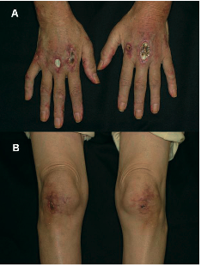
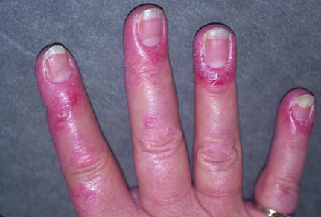
Skin changes predictive of cancer in DM

Slide 51
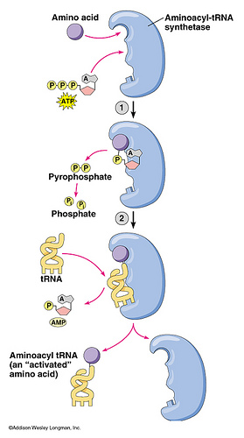
Antisynthetase syndrome
Notes:
Aminoacyl-tRNAs are substrates for translation and are pivotal in determining how the genetic code is interpreted as amino acids. The function of aminoacyl-tRNA synthesis is to precisely match amino acids with tRNAs containing the corresponding anticodon. This is primarily achieved by the direct attachment of an amino acid to the corresponding tRNA by an aminoacyl-tRNAsynthetase, although intrinsic proofreading and extrinsic editing are also essential in several cases.
The major role of the ribosome is to catalyse coupling of amino acids into protein according to the sequence specified by the mRNA. The amino acids are brought to the ribosome by tRNA (transfer RNA) molecules.

Slide 52
Aminoacyl-tRNAsynthetase
All are located in the cytoplasm
Catalyze the attachment of a particular amino acid to its transfer RNA (tRNA).

Slide 53
Antisynthetase antibodies
Aminoacyl-tRNA(ag) Antisynthetase(ab)
Histidyl-tRNA Jo-1
Threonyl-tRNA PL-7
Alanyl-tRNA PL-12
Isoleucyl-tRNA OJ
Glycyl-tRNA EJ
Asparaginyl-tRNA KS

Slide 54
Clinical manifestation of ASS
Myositis
Interstitial lung disease
Arthritis
Raynaud's phenomenon
Fever
Mechanic’s hands

Slide 55
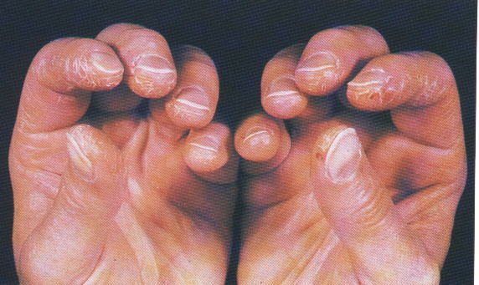
Mechanic’s hands
Notes:
Scaling, hyper keratosis and cracking of the skin

Slide 56
ASS muscle pathology
Preferential involvement of the perifasicular regions
Changes are less severe than DM
No capillary depletion

Slide 57
Antisynthetase syndrome-JO1

Slide 58
Autoimmune myopathy without inflammation
Subacute onset of symmetric proximal muscle weakness
Rheumatological markers are negative
Markedly elevated CK level
EMG with fibrillation potentials and positive sharp waves
Muscle biopsy shows no inflammation with mildly active myopathy or necrotizing myopathy
Most often, there is delay in the diagnosis and treatment

Slide 59
Illustrative case
44 Y/O male with rapid progressive, symmetric proximal upper and lower limb muscle weakness, wheelchair bound within a year
CK 9399 U/L, negative ANA and ENA, EMG diffuse myopathy with prominent fibrillation potentials and myopathic MUP’s
Two biopsies of right and left quadriceps, first showed necrotizing myopathy without inflammation, second showed severe muscle fiber atrophy and endomysial fibrosis

Slide 60
Illustrative case
Seen by neurology and rheumatology, treated with adequate dose of prednisone, Methotrexate and weekly IVIG for 6 moths without improvement
Four years after presentation sent for evaluation of muscular dystrophy
Exam: in wheelchair, can not stand by himself, severe atrophy and weakness of proximal and axial muscles

Slide 61
Illustrative case

Slide 62
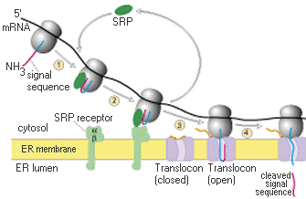
Signal Recognition Particle
Notes:
When proteins are synthesized, any newly made signal sequence or transmembrane domain that pops out of the ribosome will be recognized by the signal recognition particle. This large complex will then inhibit further translation of the protein and target the newly made signal sequence or transmembrane domain and the translating ribosome to the surface of the endoplasmic reticulum (ER) due to the action of the SRP receptor. Once the entire complex is at the membrane, SRP transfers the signal sequence or transmembrane domain to the translocon, a channel that allows proteins to be inserted into the lumen of ER. Next the ribosome positions itself so that it sits on top of the translocon and then resumes protein synthesis. As a result, the ribosome feeds the rest of the newly synthesized polypeptide directly into the channel.

Slide 63
Signal recognition particle (SRP)
Ribonucleoproteins that recognizes and transfers specific amino acids to the endoplasmic reticulum
Binds to ER signal sequences
It also binds to ribosome, pauses translation until the entire SRP-bound translation complex is transported to ER

Slide 64
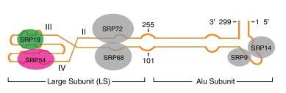
Signal recognition particle (SRP)

Slide 65
Anti-SRP antibody associated myopathy
Children to adults
Severe proximal muscle weakness
Most patients are severely disabled or wheelchair bound
CK markedly elevated 15-30 times the upper limit of normal
Miller T, J of neurolneurosurg& psychiatry, 2002
Kelly A, J of rheumatol 2008

Slide 66
Anti-SRP antibody associated myopathy
Rheumaological markers are negative
EMG shows myopathic changes with fibrillation potentials
Most cases respond poorly to immunotherapy

Slide 67
Anti-SRP antibody muscle pathology
Necrotizing myopathy with minimal or no inflammation
Marked endomysial fibrosis, can be mistaken for muscular dystrophy

Slide 68
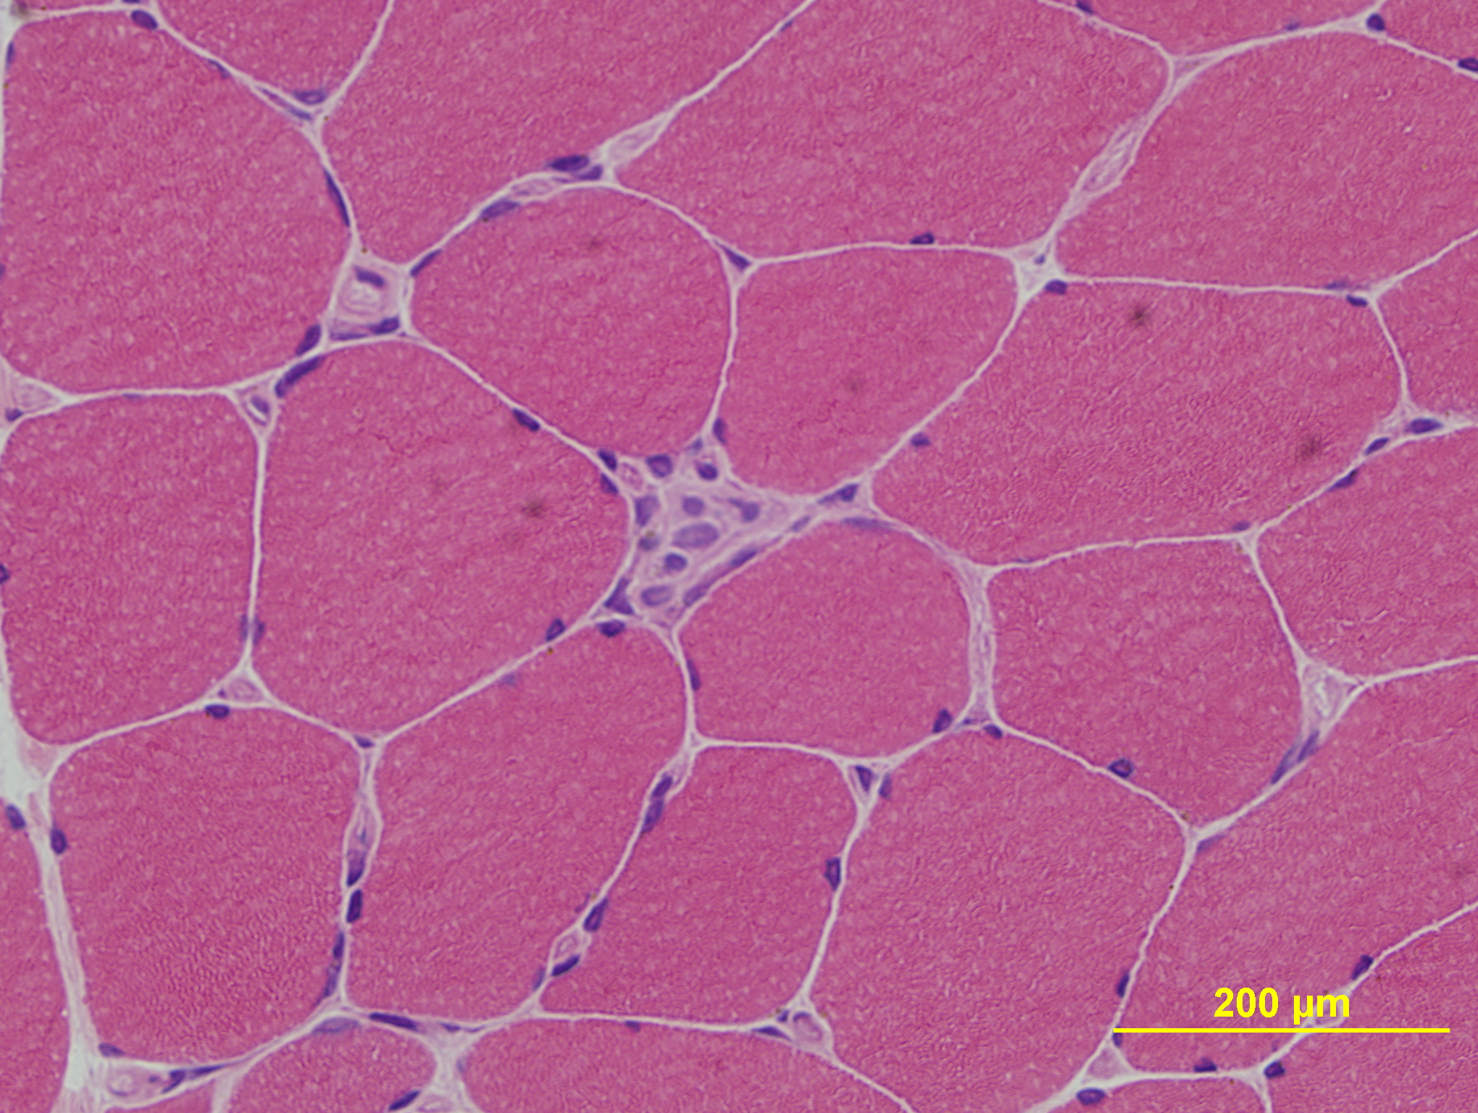
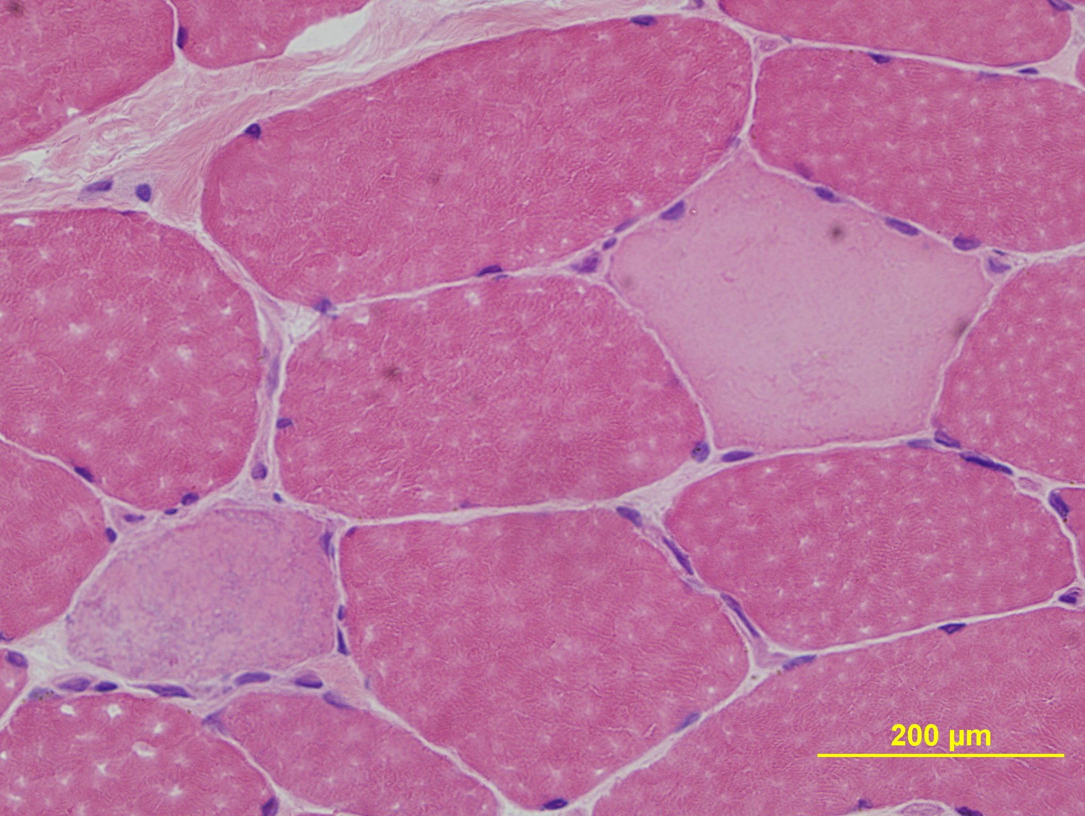
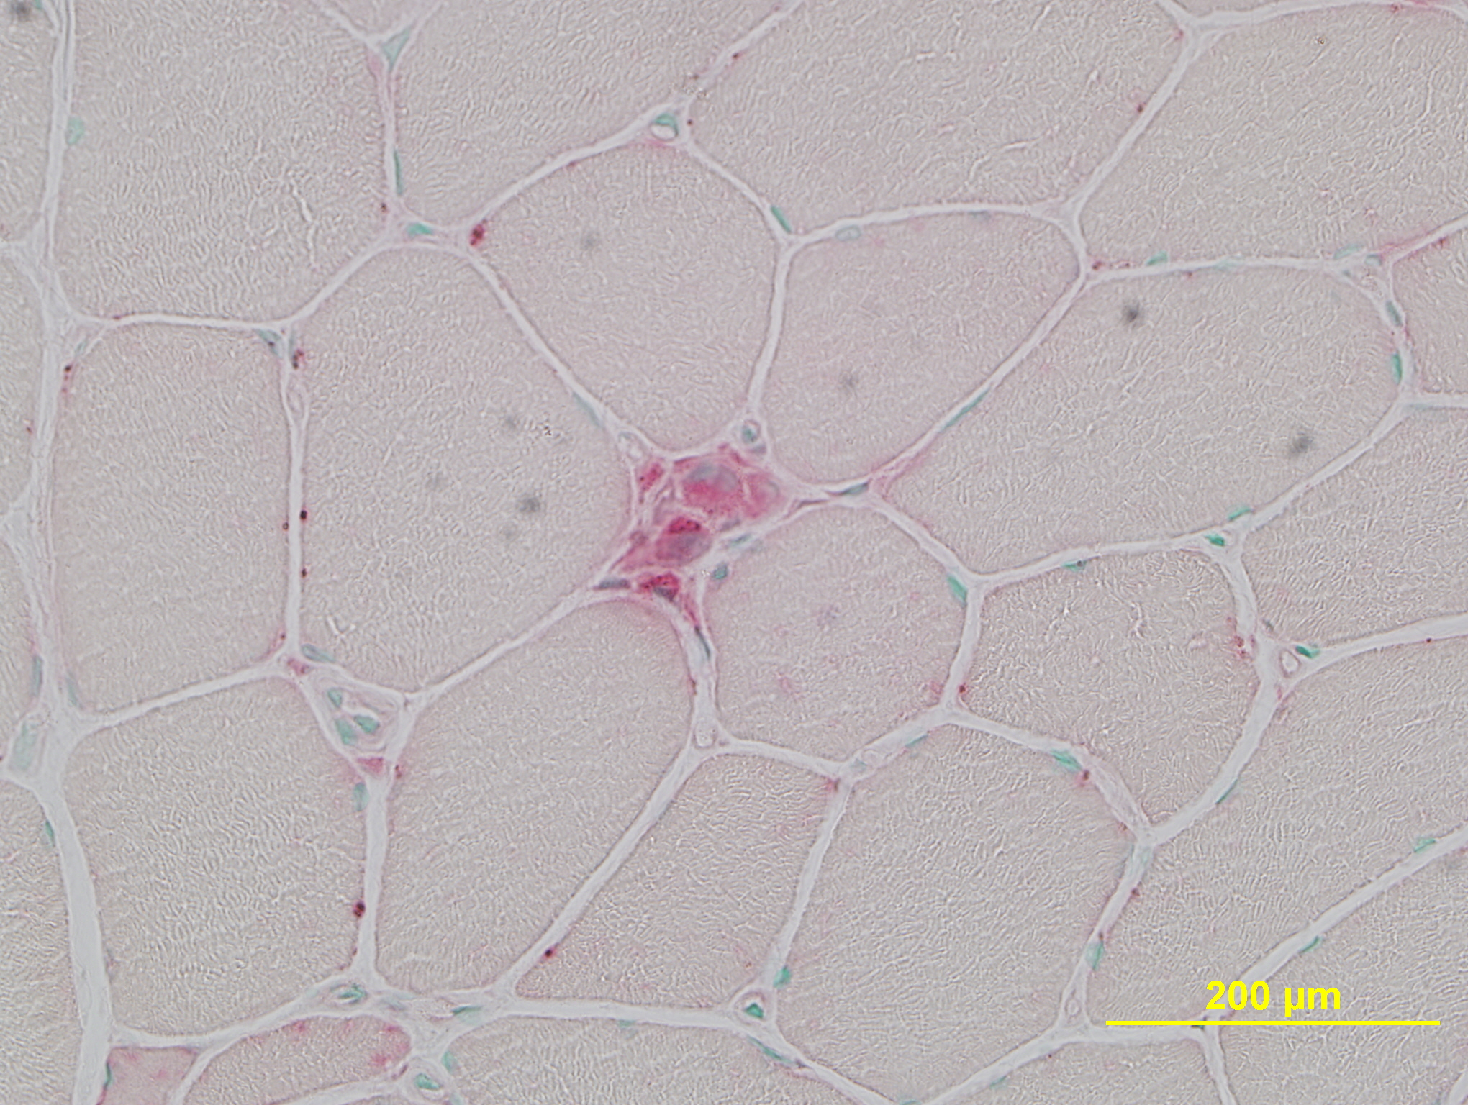
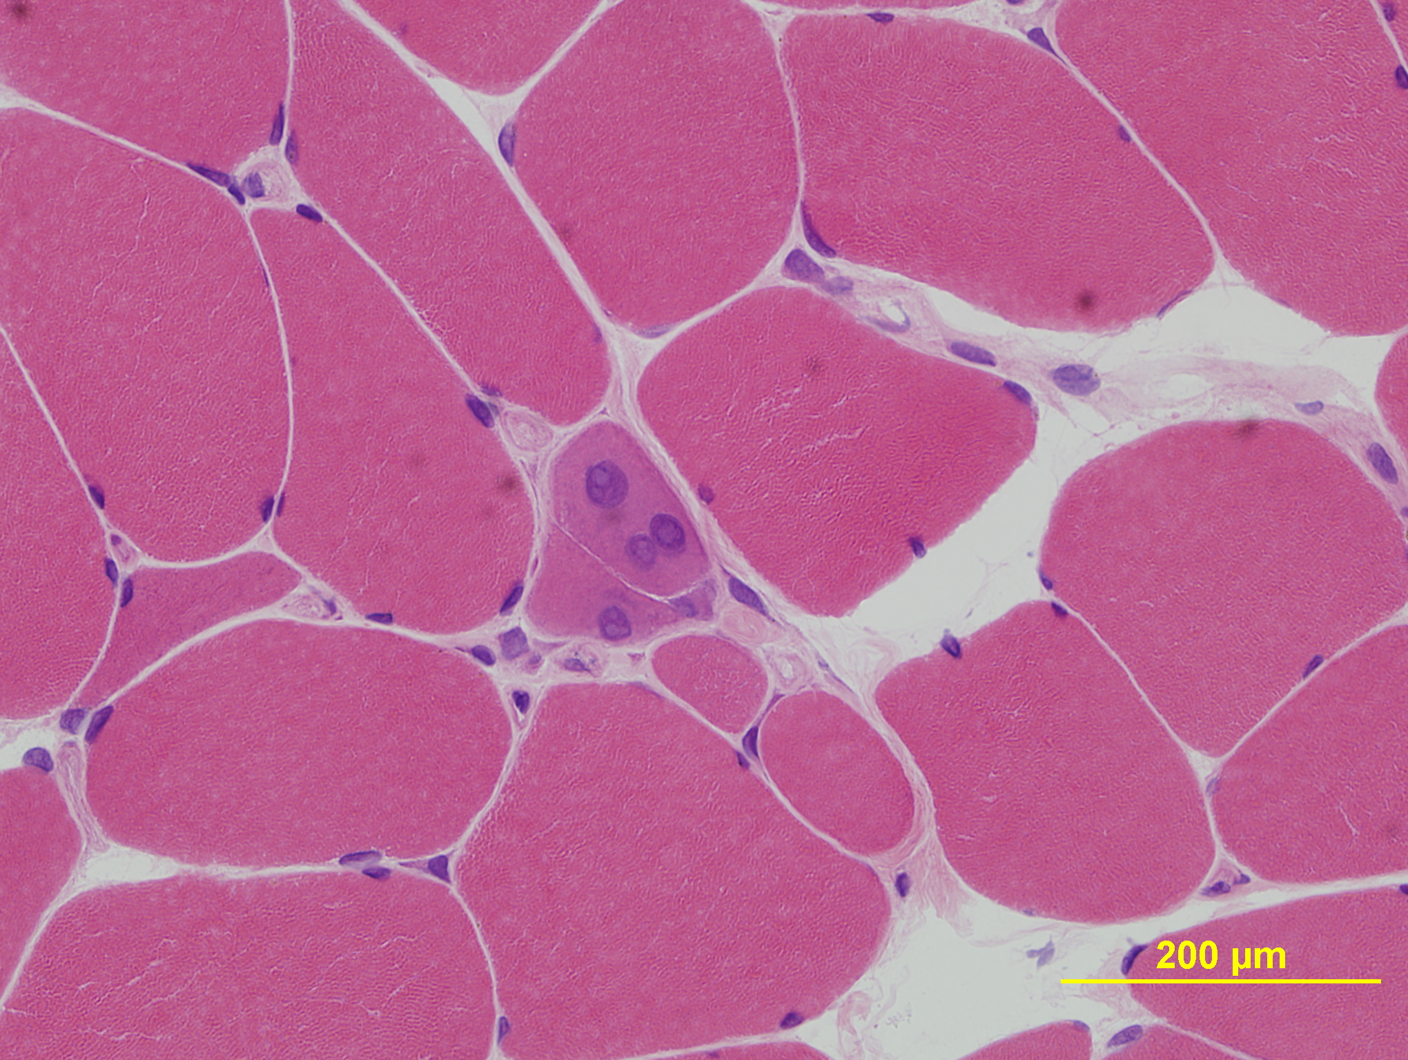
Anti-SRP antibody associated myopathy

Slide 69
Myositis antibodies
Anti-Jo1, PL7, PL12, EJ, OJ, KS ASS
Anti-SRP Necrotizing myo
Anti-Mi-2 DM
Anti-U1RNP MCTD
Anti-U2RNP MCTD
Anti-KU PM-SSc
Anti-PM-Scl PM-SSc

Slide 70
Illustrative case
71 Y/O male with 6 month history of very rapid progressive, severe proximal muscle weakness presented for third opinion
Has H/O hyperlipedmia and was on atorvastatin (Lipitor) 40 mg once a day for 1 year
Lipitor was D/C, 2 months prior to presentation, but continued to get worse

Slide 71
Illustrative case
Two muscle biopsies of left biceps and right thigh showed few regenerating and necrotic fibers without inflammation
EMG showed proximal myopathy with prominent fibrillation potentials
Was given different diagnoses including IBM and toxic myopathy due to statin

Slide 72
illustrative
In a wheelchair, marked weakness of his deltoid, external shoulder rotators, severe weakness of his iliopsoas, can not lift his leg off the floor, but normal quadriceps
CK 8,000-11, 000 U/L
Negative ANA, ENA, DNA, RF, Paraneoplastic antibodies, myositis profile
Treated with prednisone 1 mg/kg and Methotrexate 20 mg once a week with marked improvement of his symptoms

Slide 73
? Statin-associated autoimmune myopathy
5 men and 3 women
Develop severe muscle weakness while on 3-hydroxy-3-methylglutaryl coenzyme A (HMG-CoA) reductase inhibitors
Average age at presentation 67 Yrs(58-75)
Grable-esposito P, muscle and nerve 2010
Notes:
we have seen 6 patient who develop similar weakness pattern and muscle biopsy findings while on the statin

Slide 74
? Statin-associated autoimmune myopathy
Seven were exposed t0 atorvastatin (10-80 mg), and one to rosuvastatin (5 mg) , for an average period 22 mo(2-48)
Severe subacute symmetric proximal muscle weakness
Selective involvement of the iliopsoas and external shoulder rotators
Discontinuation of the medication on average 6 mo (2-12) did not result in any improvement

Slide 75
? Statin-associated autoimmune myopathy
CK ranged from 3665-21323 U/L, average 8932
Rheumatological markers and myositis panel were negative in all
EMG showed myopathic changes with fibrillation potentials in all
None had or developed cancer
Treatment with prednisone alone was not effective
All patients required other immunotherapy for completer or near complete improvement
Average time for maximal improvement was about 5 mo

Slide 76
? Statin-associated autoimmune myositis, muscle pathology
Very similar to SRP antibody associated myopathy
Muscle biopsy shows necrotizing myopathy or scattered necrotic fibers
Minimal or no inflammation

Slide 77
? Statin-associated autoimmune myopathy

Slide 78
Statins
Down regulate T-cell activation and proliferation
Block adhesion molecules interactions
Inhibit the production of chemokines and matrix metalloproteinases (MMPs)
Attenuate MHC-II restricted antigen presentation
Inhibit the activation of NFκB
Reduce leukocyte migration
Shift the T-cell population from proinflammatory TH1 to a regulatory TH2 phenotype
Greenwood J, trends in immunology, Feb 2007

Slide 79
Statin and autoimmune myopathy
? Coincidence
Interference with SRP or its receptor

Slide 80
Treatment of inflammatory myopathy
Except for IVIG, there has been no controlled trials
All studies
  Open label study of small number of patients
  Case reports
Notes:
There have been no double controlled trials in any of the medication except IVIG
What we know is from an open label study on small group of patients or case studies.

Slide 81
Treatment of IBM
Refractory to treatment
Some use 3-6 months trial of prednisone or Azathioprine or Methotrexate or Mycophenolate Mofetil
Ongoing trials
  Arimoclomol, coinducer of heat shock proteins
  Etanercept ( TNF)
  Lithium

Slide 82
Treatment of IBM
Alemtuzumab (Campath), a humanized monoclonal antibody against the peripheral lymphocyte cells
13 patients treated with 4 doses 0.3 mg/kg
11.4% improvement on the MRC and 13% on quantitative muscle strength testing
Dalakas MC, Brain 2009

Slide 83
Treatment of inflammatory myopathy
Ongoing studies
  Infliximab (TNF), completed
  Rituximab for refractory myositis, recruiting
  Stem cell transplantation, recruiting
Notes:
There have been no double controlled trials in any of the medication except IVIG
What we know is from an open label study on small group of patients or case studies.

Slide 84
Treatment of inflammatory myopathy (first line treatment)
Prednisone
Azathioprine
Methotrexate
Mycophenolate Mofetil
Notes:
First line drugs in the treatment

Slide 85
Treatment of refractory inflammatory myopathy
IVIG
Plasmapheresis
Cyclosporine and Tacrolimus
Cyclophosphamide
Rituximab
Infliximab
Etanercept

Slide 86
Conclusions
PM by pathological definition is the least common among all the inflammatory myopathy
IBM is the most common, unfortunately no effective treatment
Severe muscle weakness in anti-SRP ab associated myopathy and ? statin-associated autoimmune myopathy
Anti-SRP ab associated myopathy responds poorly to treatment
Notes:
One might question why we need a muscle biopsy, 1-because it might confirm the diagnosis and second ably as we see all these medication has serious side effects

Slide 87
Conclusions
Rash in DM and ASS
ILD in DM and ASS
Serum CK, Myositis antibodies and EMG study can aid in the diagnosis
DM patients should be screened for occult malignancy
Muscle biopsy still a helpful tool

Slide 88
Prednisone
1mg/kg
Reduce the production of inflammatory mediators such as cytokines, prostaglandins and nitric oxide
Inhibit inflammatory cell migration to site of inflammation
Promote leukocyte and lymphocyte death by apoptosis
Side effects: increase risk of infection, weight gain, osteoporosis, hypertension, cataract, diabetes
Notes:
The usal dose is
It is thought to work by

Slide 89
Azathioprine
2.5 mg/kg/day
It reduces the intracellular synthesis of purine and decreases the number of circulating B and T cells, particularly CD8+ cells
Individuals with low activity of key metabolic enzyme called ThioPurine MethylTransferase (TPMT), are more susceptible to azathioprine-induced myelosuppression
Side effects: acute hypersensitivity reaction, pancreatitis, bone marrow suppression, hepatotoxicity, neoplasia
Notes:
inhibition of enzymes involved in purine metabolism, leading to accumulation of adenosine, or the inhibition of T cell activation and suppression of intercellular adhesion molecule expression by T cells
Every body who is being started on Aza should have TPMT

Slide 90
Methotrexate
0.3 mg/kg/week
Should be administered with folic acid 1 mg/d
inhibition of T cell activation and suppression of intracellular adhesion molecule expression by T cells
Side effects: bone marrow suppression, hepatotoxicity, interstitial pneumonitis and pulmonary fibrosis
Notes:
Convenient once a week

Slide 91
Mycophenolate Mofetil
25mg/kg/day, the active metabolite, mycophenolic acid (MPA), inhibit proliferation of T and B-cells
Side effects: bone marrow suppression, hepatotoxicity, PML
Notes:
Cases of PML in transplant patients

Slide 92
IVIG
2g/kg
Side effects: anaphylactic reaction, aseptic meningitis, acute renal failure, venous thrombosis, CVA, heart attack, cardiac arrhythmias
Notes:
Safe, but side effects can occur in 5%

Slide 93
IVIG
Double-blind, placebo controlled study was effective in DM
Double-blind, placebo controlled study did not find any significant efficacy in IBM on muscle strength, but patient with dysphagia had improved
Notes:
Two

Slide 94
Cyclosporine A and Tacrolimus
Suppress T-cell function
Cyclosporine A 2-5 mg/kg/day ( trough level 100-200 ng/ml)
Tacrolimus 0.075-0.2 mg/kg/day, divided twice a day ( trough level 5-20 ng/ml)
Side effects: renal insufficiency, hypertension, hepatotoxicity, seizures, hypomagnesaemia, PRES

Slide 95
Cyclophosphamide
2 mg/kg/d orally or 0.5-1 mg/m² IV monthly for 6 months
Suppresses T-cell function
Side effects: bone marrow suppression, hemorrhagic cystitis, increased risk for malignancies, especially lymphoma, leukemia and bladder cancer

Slide 96
Rituximab(Rituxan)
Monoclonal antibody directed toward CD20, an antigen expressed on lymphocytes of B-cell lineage
375 mg/m² IV weekly for 4 consecutive weeks
Side effects: bone marrow suppression, pulmonary and GI complains
Severe fatal infusion reaction, tumor lysis syndrome, PML, severe mucocutaneous reaction, hepatitis B reactivation with fulminant hepatitis

Slide 97
Tumor Necrosis Factor-alpha (TNF-α) monoclonal antibody
Infliximab (Remicade) 5mg/kg, then at week 2, 6 and 14 weeks thereafter,
Side effects: increase risk of infection, hepatosplenic T-cell lymphoma, bone marrow suppression, severe hepatotoxicity, lupus-like syndrome, increased risk of malignancy
Etanercept (Enbrel), 50 mg once or twice a week
Side effects: increased risk of infection, especially URI and increased risk for malignancy especially lymphoma

